Slide 1

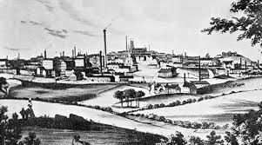
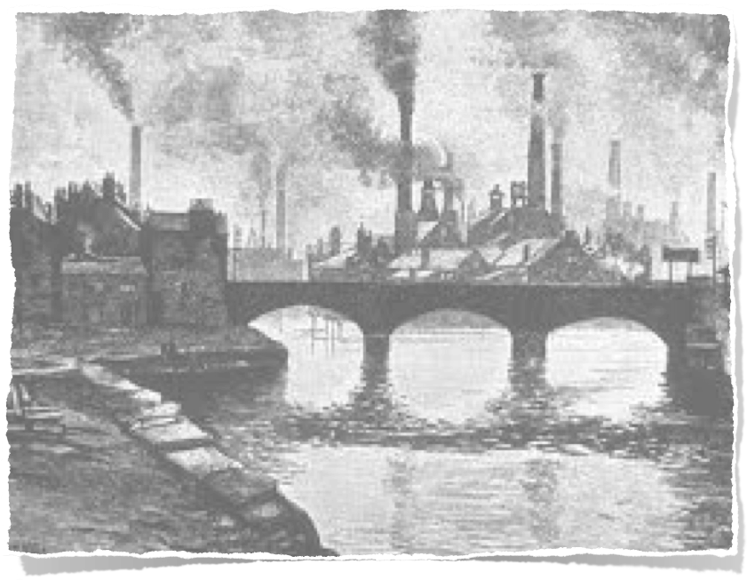

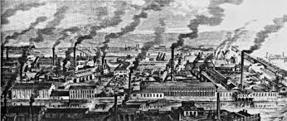
AP WORLD HISTORY
CH.17 Revolutions of Industrialization
1750-1914

Slide 2
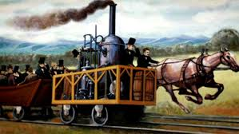
      In the biggest events that promoted human history, the industrial revolution that took place in the nineteenth century was definitely among the best.
Its influence is so strong that people still People have benefited from it so far, such as the discovery of power energy, the appearance of new social structure, and lots of new inventions…

Slide 3
So, let’s start our sources analysis !

Slide 4
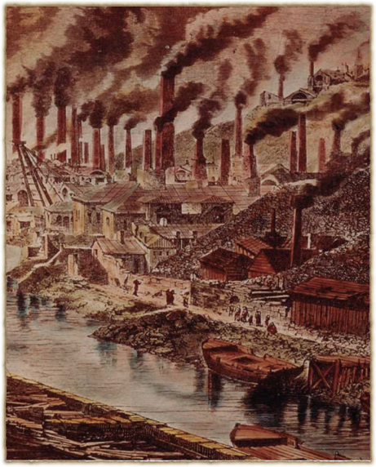
Vivian’s copper foundry
Artist name: Durand-Brager
Time period:1865
Context:The original wood engraving is mainly about a part of sight of Swansea, United Kingdom (Wales). Surrounding the harbor are industrial factories that produce copper for a company called Vivian. Countless stacks that standing in the flood of factories is belching black smoke. Everything in the engraving looks gray and heavy, with a strong industrial Atmosphere.
Relation:This shows the impact of the industrial revolution on Britain, the prosperity of industrialization. Because the need of industrial development, the energy change from human labor to mine, the place that holds the source was heavily mined. That excessive action caused big environmental problems.
foundry A foundry is a place where metal or glass is melted and formed into particular shapes.
Swansea a port city in southern Wales on an inlet of the Bristol Channel, during its 19th-century industrial heyday, Swansea was a key centre of the copper industry, earning the nickname 'Copperopolis'.

Slide 5
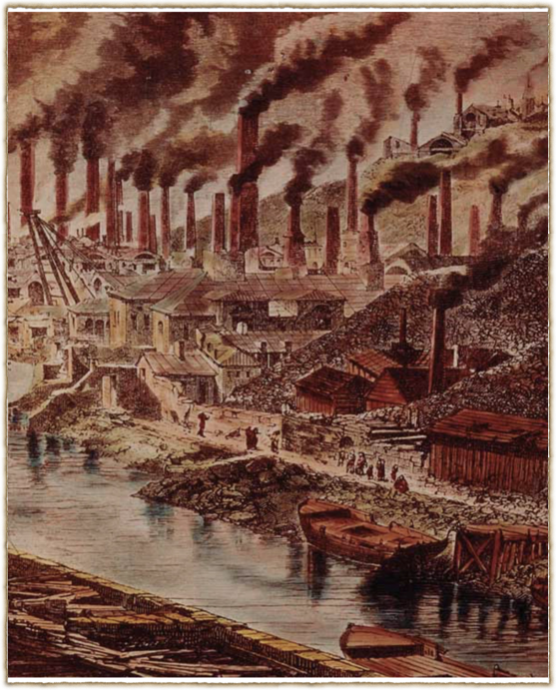
H The industrial revolution is sweeping across England, it's explain why bunches of factories sat around the edge of Swansea.
I For those who did not witness the industrial revolution, those who wishes to study the history of industrial revolution, and include some who were overdeveloped at that time. we can see this from the image. The sky of the bay is already occupied by the black smoke that coming from factories. From the original one, the whole picture is a grayish hue.
P Durand-Brager, English, an artist.He was shocked by the industrial revolution and worried about the environment, which made him emphasize the depiction of factories and black smoke.
P A lot of industrial pollution caused by immature industrial technology，serious environmental problems appeared in Britain. Call on the country on the road to industrialization, but also can not forget the environment

Slide 6
Kitty’s turn.

Slide 7
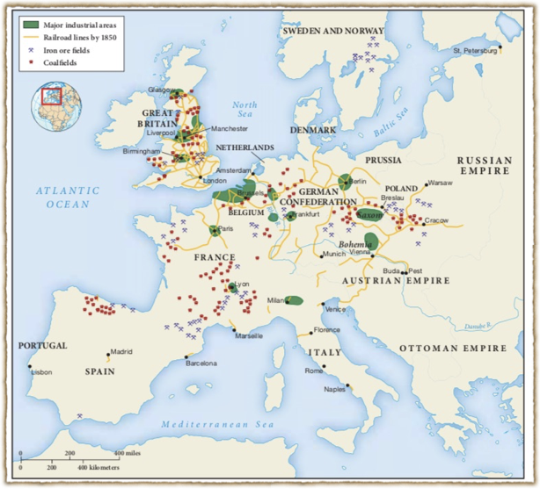
The Early Phase of Europe’s Industrial Revolution
time period:1850
context: It is the map for the places that has already started the industrialization, which include Great Britain, France, Germany, Belgium, Bohemia and Italy.
Relationship to the theme: Right dot is the coal fields, the blue one is the Iron ore fields, the yellow lines are the railroad lines by the 1850, and the green areas are the major industrial areas. From the location of the green areas, we can see that the places that had the most part of the green areas had the coal, the iron at the same time. As a results, they have railroads to connect with each other.

Slide 8
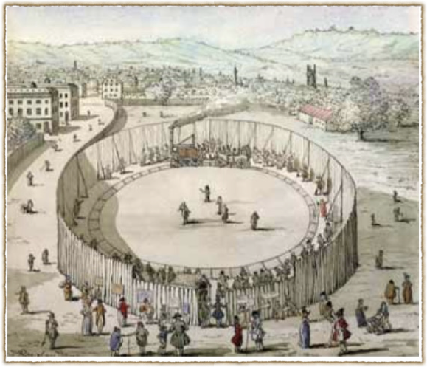
Richard Trevithick’s Railroad, Euston Square in 1809
Time Period:1809 Thomas Rowlandson
Context: This painting showed that the popularity of the railroads, like it could be used as an entertainment facilities.
Relationship to the theme: The popularity of the railroads is a symbol of the Industrial Revolution

Slide 9
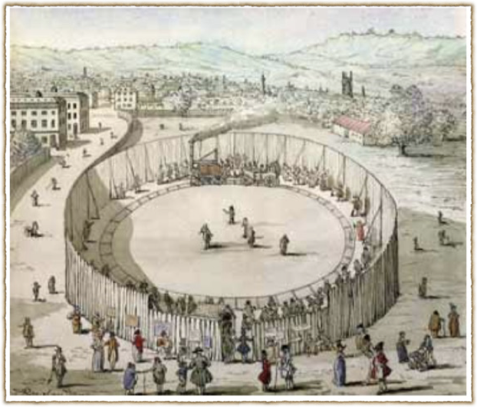
Hipp:
H: During that time period, railroad had already been known and used by the masses. Like people used it to travel or even for fun. This give us a better understanding of why this railroad is kind of different from others, and also provide us a strong evidence of machines changed human’s lives.
I: people who don’t know railroad from that time period and people after
P: the author is Thomas Rowlandson, he could make more people to know the railroad and also let us figure out what the world looked like during that time. They have railroad for entertainment also showed that this country was wealth enough.
P: he would like to record the society

Slide 10
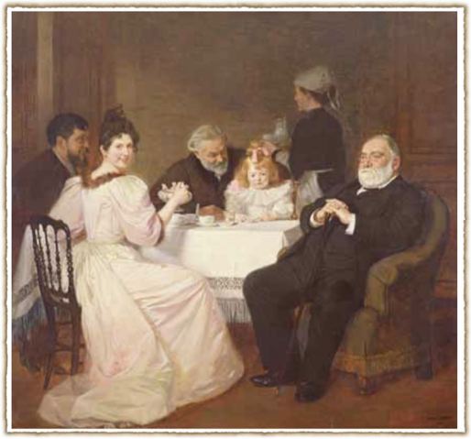
Family Reunion at the Home of Madame Adolphe Brisson
Time period: 1893 Marcel André Baschet
context: This late nineteenth-century painting shows a prosperous French middle-class family, attended by a servant. To hire a servant become a symbol of the middle class.
Relationship to the theme: Industrial Revolution changed people’s mind to the status, especially for the middle class. One of the reason is like, to hire a servant could manifest their “special” status.

Slide 11
Sophia’s turn%

Slide 12
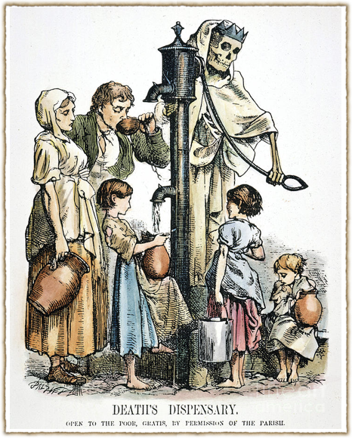
The Urban Poor of Industrial Britain
This 1866 political cartoon shows an impoverished urban family forced to draw its drinking water from a polluted public well, while a figure of Death operates the pump. (The Granger Collection, NYC — All rights reserved)
H: This picture cartoon reflected the cholera in London. In 19th century, plenty of people move to urban area since the industrial revolution. They work in the factories. The city is very crowded and they don’t have a good sanitation system. When people drink the water from the water pump which is polluted by the feces, they get a disease called Cholera. This disease caused nearly 78000 people dead. But this also helps European know the importance of sanitation system and develop it.
I: Upper classes and wealthy people and it reflected the social problems
P: This reflects the life of poor people and the effect of the disease.
P: Let people know this and improve this system.

Slide 13
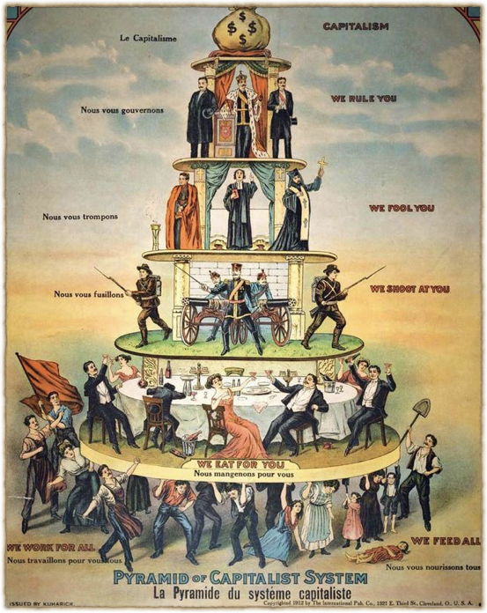
The Socialist
Outlook
This 1911 poster was first published in the newspaper of the Industrial Workers of the World, a radical American trade union organization. It illustrates a socialist perspective on capitalist societies. At the bottom of the pyramid, supporting the entire social edifice, are the workers, while above them are arrayed the various oppressive layers of the social hierarchy: the bourgeoisie, the police and militias, religious figures, and state officials. (From Pyramid of Capitalist System, issued by Nedelkovich, Brashick and Kuharich, Cleveland [International Publishing Company, 1911]/photo: IAM/akg-images)

Slide 14
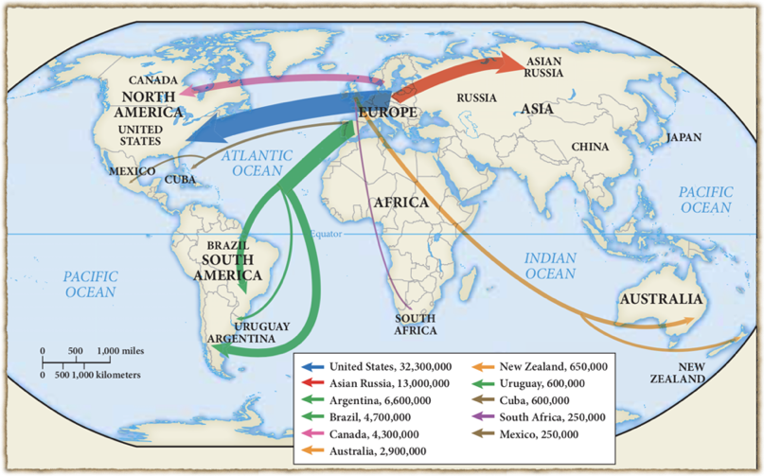
European Migration in the Industrial Age
Europe’s Industrial Revolution prompted a massive migratory process that uprooted many millions around the globe. More significant for world history was the exodus between 1815 and 1939 of fully 20 percent of Europe’s population, there were 50 to 55 millions of people spread across the world. They were pushed by poverty, a rapidly growing population, and the displacement of peasant farming and artisan manufacturing. And they were pulled abroad by the enormous demand for labor overseas, the ready availability of land in some places, and the relatively cheap transportation of railroads and steamships. In 1800, less than 1 percent of the total world population consisted of overseas Europeans and their descendants; by 1930, they represented 11 percent.

Slide 15
Flora’s turn!

Slide 16
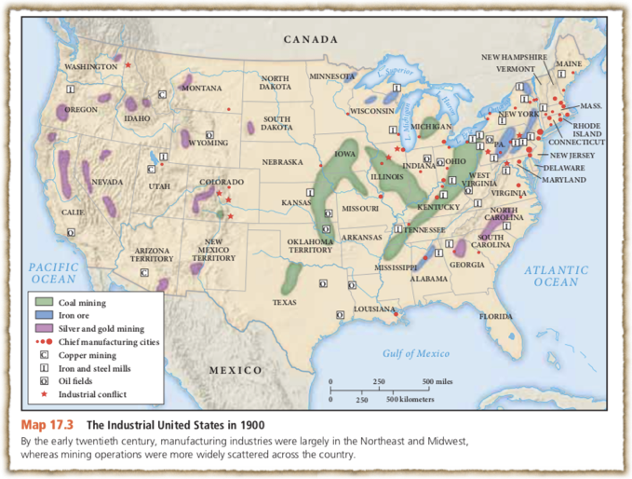
The Industrial United States in 1900
Time period: 1900
Context: by the early. 20th century, manufacturing industries were largely in the Northeast and Midwest, whereas mining operations were more widely scattered across the country.
Relationship to the theme: American industrialization began in the textile factories of New England during the 1820s but grew explosively in the half century following the Civil War (1861– 1865). The country’s huge size, the ready availability of natural resources, its expanding domestic market, and its relative political stability combined to make the United States the world’s leading industrial power by 1914.
Terms: American Industrialization, Civil War

Slide 17
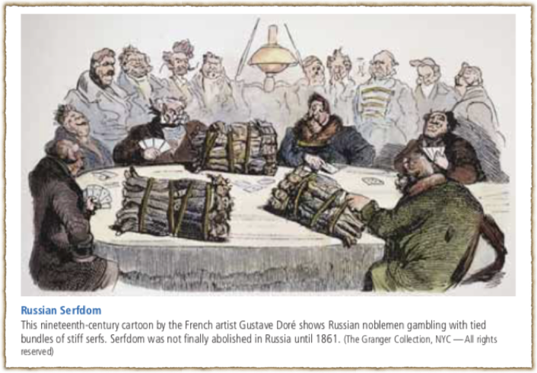
Russian Serfdom
Artist name: Gustave Doré
Time period: 1854
Context: Russian noblemen gambling with tied bundles of stiff serfs, who were forced to live and work on land that belonged to a landowner whom they had to obey. Until 1861, most Russians were peasant serfs, bound to the estates of their masters, subject to sale, greatly exploited, and largely at the mercy of their owners.
Relationship to the theme: To many thoughtful Russians, serfdom seemed incompatible with modern civilization and held back the country’s overall development, as did its economic and industrial backwardness. Thus, beginning in the 1860s, Russia began a program of industrial development.
Terms: Russian Serfdom.

Slide 18
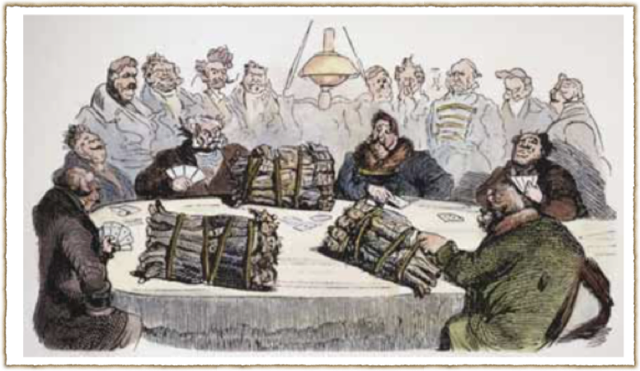
History Context
- Russian society was dominated by a titled nobility of various ranks
- they owned serfs - miserable slaves
- Most of populations were serfs
- No enough free labor of industry - government didn’t support
- Freed in 1861
Intended audience
French people
French rich people
French government
Point of view
French Artist
Criticizing
Purpose
Amuse
Criticize

Slide 19
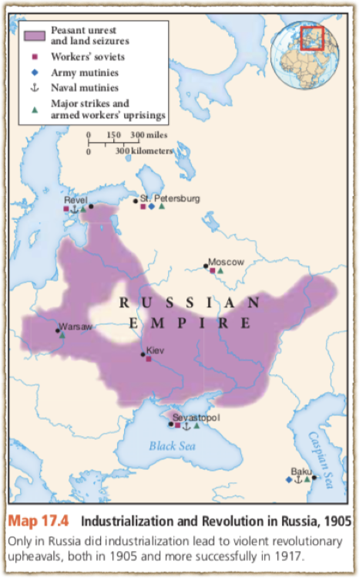
Industrialization and Revolution
in Russia, 1905
Time period: 1905
Context:In 1905, following its defeat in a naval war with Japan, Russia erupted in spontaneous insurrection.
Relationship to the theme: The 1905 revolution, though brutally suppressed, forced the tsar’s regime to make more substantial reforms than it had ever contemplated, which developed Industrialization at a rapid rate.
Terms:
Peter the Great, Crimean War, Russia’s Industrial Revolution, illegal Russian Social-Democratic Labor Party.

Slide 20
Amber’s turn@

Slide 21
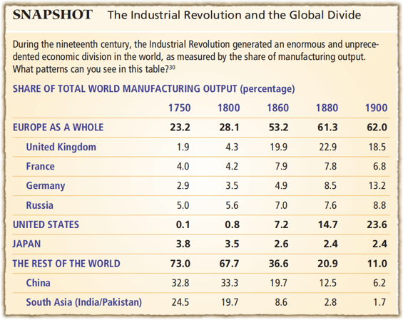
The Industrial Revolution and the Global Divide
Time period: 1750-1900
Explain: This table shows the change of share of total world manufacturing output from 1750 to 1900. In this 150 years, because of Industrial revolution, industrial countries in European such as UK became a major part of manufacturing and also United States which also had the industrial revolution. But in Asia, their productivity plummeted rapidly, such as China, from the former top of the world became a more vulnerable country.
Need to know: The Industrial Revolution was the transition to new manufacturing processes in Europe and the US, in the period from about 1760 to sometime between 1820 and 1840. This transition included going from hand production methods to machines, new chemical manufacturing and iron production processes, the increasing use of steam power and water power, the development of machine tools and the rise of the mechanized factory system. The Industrial Revolution also led to an unprecedented rise in the rate of population growth.

Slide 22
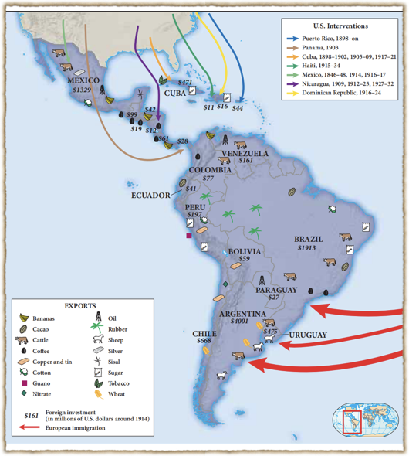
Latin America and the World, 1825–1935
During the nineteenth and early twentieth centuries, Latin American countries interacted with the industrializing world via investment, trade, immigration, and military intervention from the United State.
Explain: During the second half of the nineteenth century, a measure of political consolidation took hold in Latin America, and Latin America as a whole became more closely integrated into a world economy driven by the industrialization of Western Europe and North America. The most significant economic outcome of this growing integration was a rapid growth of Latin American exports to the industrializing countries, which now needed the food products, raw materials, and markets of these new nations. They sold products such as Silver, Copper and tin, Guano, sisal etc to those industrializing countries. In return for these primary products, Latin Americans imported the textiles, machinery, tools, weapons, and luxury goods of Europe and the United States. Anyway, Latin America was financed by exports to industrialized countries abroad.
Relationship with our theme: Industrial Revolution This map shows the transportation between Latin America and the whole world, connecting to the history Latin America sold their products all over the world to those industrialization countries.

Slide 23
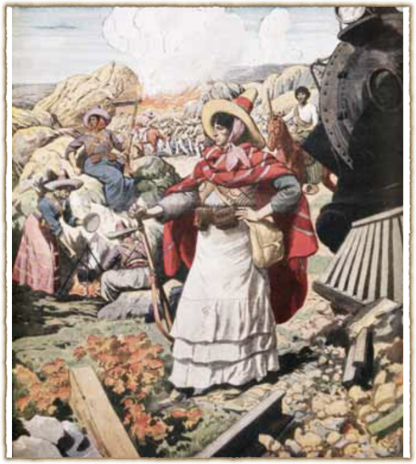
The Mexican Revolution
Women were active participants in the Mexican Revolution. They prepared food, nursed the wounded, washed clothes, and at times served as soldiers on the battlefield.
Time period: 1913
Relationship with our theme: In the early 19th century, after Mexico got rid of the Spanish colonial rule and gained independence, its social and economic structure did not change much.The Catholic church still held a lot of power, and capitalist forces such as Britain, America and France soon replaced the Spanish colonists and controlled the economic lifeline of Mexico.The reactionary political clique colluded with foreign forces, contended for power and gain, suffered political instability, fell into chaos for a long time after the independence of Mexico, coups, insurrections, civil wars, foreign invasions and armed intervention, emerged one after another
Mexican Revolution: also known as the Mexican Civil War, was a major armed struggle, lasting roughly from 1910 to 1920, that radically transformed Mexican culture and government.Although recent research has focused on local and regional aspects of the Revolution, it was a genuinely national revolution.

Slide 24

👏!!Thanks!!👏

Slide 25


