Slide 1
World War II in Asia
(and the Second Sino-Japanese War)
AP World History

Slide 2
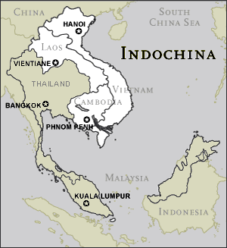
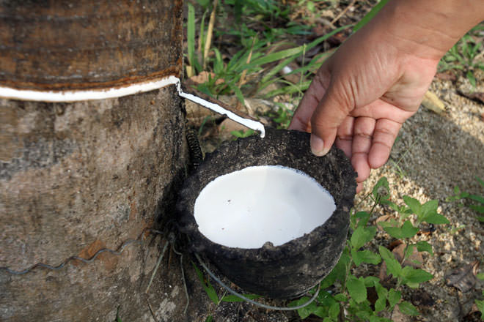
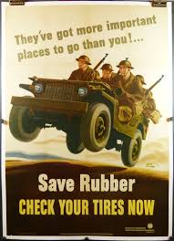
Japanese Imperialism
In the 1930s, Japan had seized much of China
Japan now set its sights on French, British, Dutch and American colonies in Southeast Asia
  Included Indochina, Malaysia, Burma, Indonesia, and the Philippines
Major target = French Indochina
  Included Vietnam, Laos, and Cambodia

Slide 3
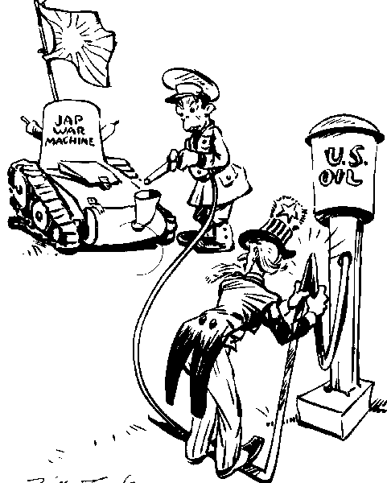
Japanese Imperialism
Japan was dependent on foreign (especially American) resources and materials
  73% of its scrap iron = from U.S.
  60% of its imported machine tools = from U.S.
  80% of its oil = from U.S.
  50% of its copper = from U.S.
Japan wanted to be economically independent
Western Europeans and Americans increasingly viewed Japan as aggressive, oppressive, and a threat to their economic interests in Southeast Asia

Slide 4
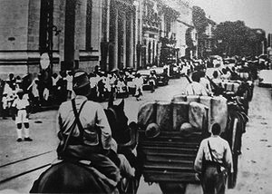
Japanese Imperialism
When Japan invaded French Indochina, the U.S. demanded that it withdraw from there AND China
When Japan refused, the United States:
  Imposed an embargo that banned the sale of scrap iron and oil to Japan
  Froze all Japanese monetary assets in the U.S.
Japan’s dilemma: cave or resist?
  If it gives in to U.S. terms, Japan seen as a weak 2nd or 3rd-rank power
  If it resists and goes to war, uncertain outcome
Japanese troops entering Saigon in northern Vietnam in 1941

Slide 5
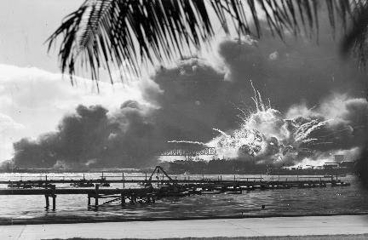
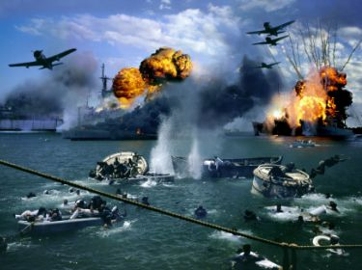
Pearl Harbor
December 7, 1941 = Japan bombed the American naval fleet based at Pearl Harbor in Hawaii
  Japan sunk or disabled 19 ships & destroyed 188 airplanes
  More than 2400 people died
  More than 1000 people were wounded

Slide 6
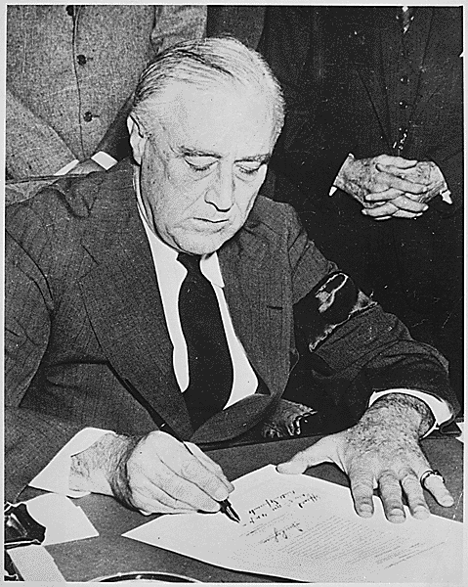
Pearl Harbor
FDR called this: “a day that will live in infamy”
December 8, 1941 = the U.S. declared war on Japan
Because Japan was allied with Italy and Germany, both Italy and Germany declared war on the U.S.
To back the U.S., Great Britain declared war on Japan

Slide 7
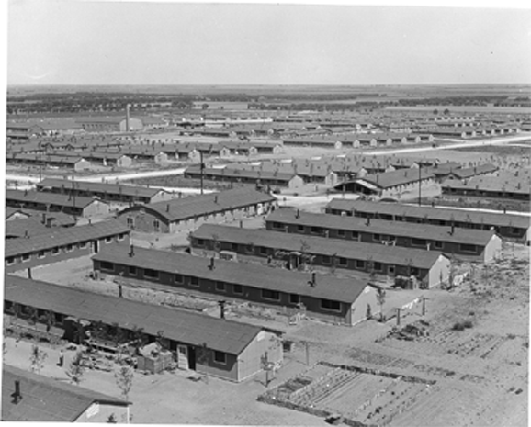
Internment Camps
After Pearl Harbor, Japanese-Americans were feared and hated by many other Americans
  Many accused of being traitors or supporting Japan
Many on the west coast were placed in internment camps = like temporary prisons until the war was over

Slide 8
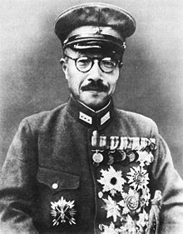
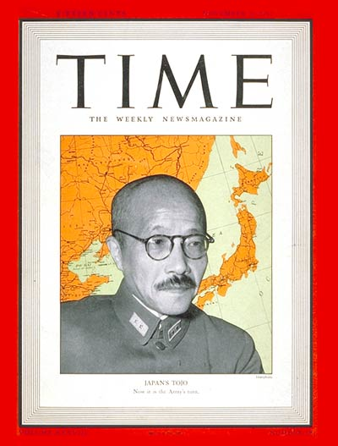
Hideki Tojo
Authoritarian Prime Minister of Japan during World War II
Very popular in Japan when WWII started because Japan’s navy was dominating that of the U.S. in battle after battle
As the tide began to turn in the Pacific, however, and the U.S. began to win battles, Tojo’s popularity declined and he faced more opposition in Japan
After Japan surrendered in WWII, Tojo was arrested for war crimes, sentenced to death, and hanged in 1948

Slide 9
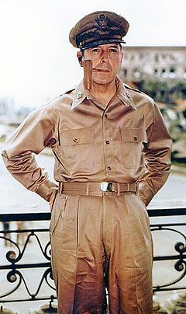
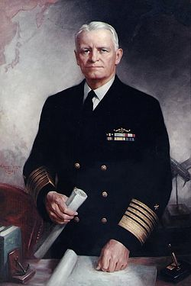



U.S. Leaders in the Pacific Theater
Douglas MacArthur
General of the Army in the Pacific Theater
Chester W. Nimitz
Fleet Admiral in the Pacific Theater

Slide 10
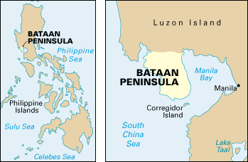
WWII in the Pacific
December 1941 – May 1942 = Japan dominating in the Pacific
    Winning battle after battle, successfully attacking U.S. naval bases, and taking over island after island

Slide 11
WWII in the Pacific
Major target for Japan during this time: the Philippines
  December 1941 = Japanese forces landed on main island of Luzon in the Philippines
  U.S. troops there were unprepared for this attack
  MacArthur took troops south to the Bataan Peninsula in hopes that U.S. army would either
    A) come with supplies and troops to back them up or
    B) rescue them

Slide 12
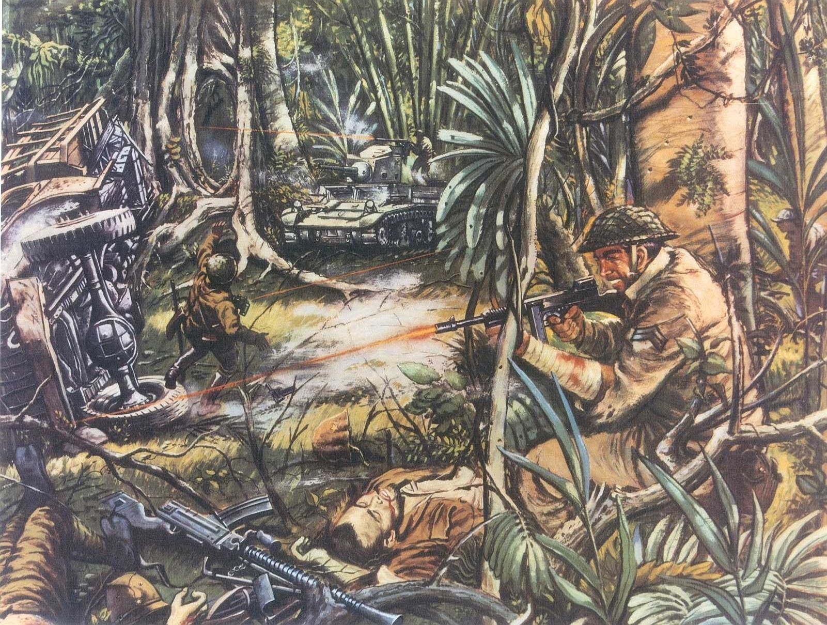
WWII in the Pacific
U.S. army never came → U.S. troops faced starvation and continuous attacks in Bataan
  Most surrendered in April 1942
2000 soldiers & nurses escaped to Corregidor, a fortified island at the tip of the peninsula
  Survived another month of attacks by living in rock tunnels
  Ran out of ammunition and food. The rest of the U.S. troops surrendered in May 1942
76,000 POWS in Bataan. All weakened by hunger, disease, and the tropical heat

Slide 13
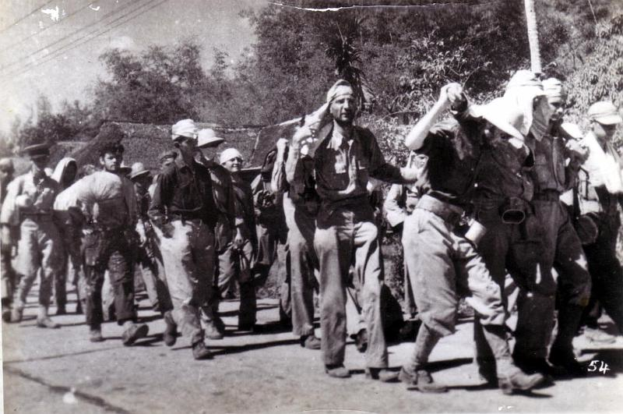
WWII in the Pacific:
Bataan Death March
Japanese split POWs into groups of 500-1000
Force marched them to a RR station 60 miles away
  Boarded a train that took them 8 miles away from the POW camp – they walked those 8 miles to the camp
Prisoners treated brutally the entire time
  Denied water
  Beaten and tortured
  Shot if too weak to continue
  At least 10,000 died marching
  About 15,000 more died in the actual POW camps

Slide 14
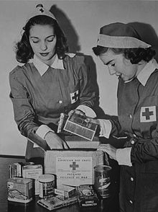
WWII in the Pacific:
Bataan Death March
Japanese actions defied POW standards outlined at the Third Geneva Convention in 1929
  Said POWs should be treated humanely and protected against violence
American Red Cross workers preparing food and packages for prisoners of war

Slide 15
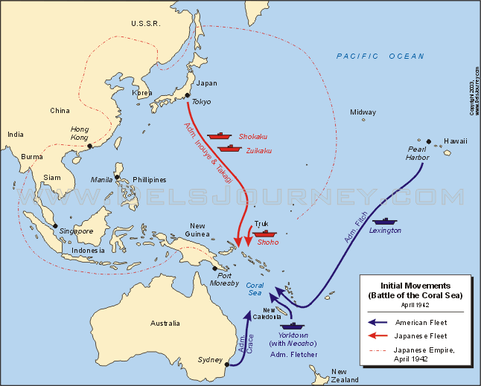
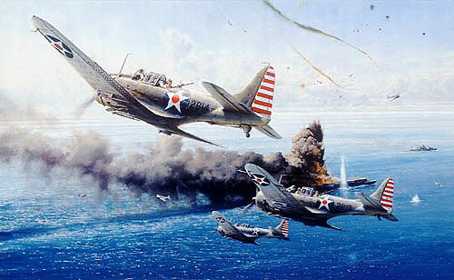
WWII in the Pacific:
Battle of the Coral Sea
May 1942, U.S. code breakers break Japanese military code
U.S. learns Japan is going to attack Australia
  U.S. decides to beat them to it and brought a fleet to the Coral Sea, northeast of Australia
5 day battle. Each side lost about ½ their planes and an aircraft carrier
Battle ended in a draw – but it kept Japan from invading Australia
  Japan’s ships were out of fuel – couldn’t make it to Australia without refueling first

Slide 16
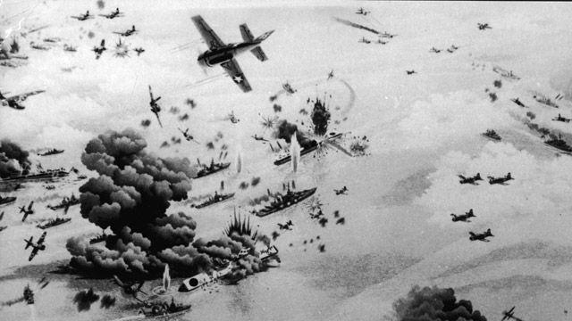
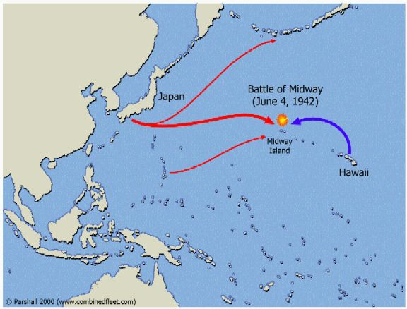
WWII in the Pacific:
Battle of Midway
June 1942, code breakers, once again, deciphered the date and location of Japan’s next big attack
  Midway was a refueling station in the middle of the Pacific
U.S. Navy plans an ambush attack there
Decisive American victory
    Irreparable damage done to Japan’s fleet
    4/5 Japanese aircraft carriers and a heavy cruiser were sunk

Slide 17
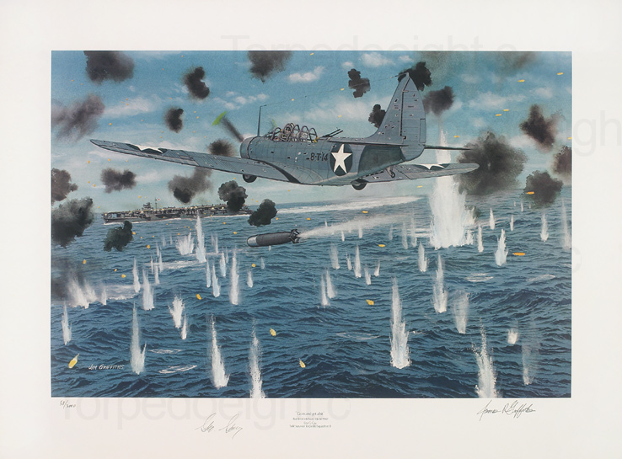
WWII in the Pacific:
Battle at Midway
This battle turned the tide in favor of the United States in the Pacific theater
Japanese shipbuilding and aircraft-building programs could not be replaced fast enough
Meanwhile, United States factories were producing ships, aircrafts, and other military supplies at a very fast pace

Slide 18
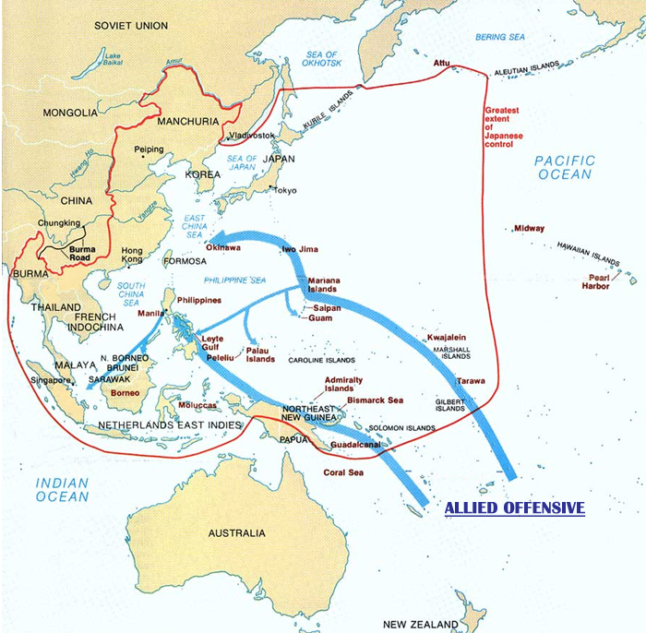
WWII in the Pacific
New U.S. strategy after Midway = “island-hopping”
  Organized by General MacArthur and Admiral Nimitz
    “Leapfrog” to Japan
  Capture some islands and bypass others
  Bypassed islands would be blockaded and cut off from supplies
1st successful victory using this strategy: Battle of Guadalcanal in August 1923

Slide 19
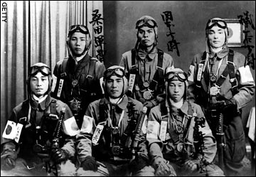
WWII in the Pacific
New Japanese strategy, use of kamikaze pilots (suicide bombers)
  Result: battles became even bloodier with higher death tolls
Nevertheless, by the end of 1944, U.S. victory over Japan seemed inevitable
  American planes continuously bombed Japanese cities
  MacArthur and his troops regained the Philippines

Slide 20
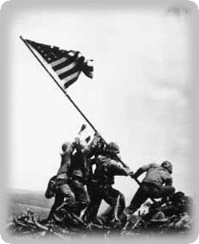
WWII in the Pacific
Early 1945, Americans defeated Japan in the two bloodiest battles of the Pacific theater
  Battles of Okinawa and Iwo Jima
General Hideki Tojo still refused to surrender
President Truman gave Tojo an ultimatum = surrender or we’ll use our new weapon, the atomic bomb
  Truman wanted to avoid the enormous loss of life that would have resulted from continued warfare in the Pacific
  Japan did not surrender

Slide 21
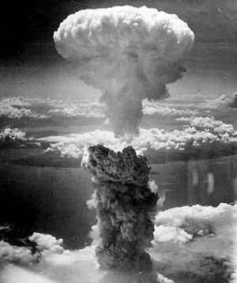
WWII in the Pacific
August 6, 1945, atomic bomb dropped on Hiroshima
  No response from Japan
August 9, 1945, second atomic bomb dropped on Nagasaki
About 200,000 Japanese died in these two cities from the explosions
  Thousands more would die in the following months and years from the blasts’ radioactivity
August 14, 1945, Japan surrendered
September 2, 1945, proclaimed V-J Day = Victory over Japan Day

Slide 22
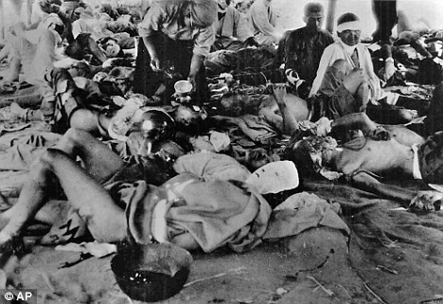
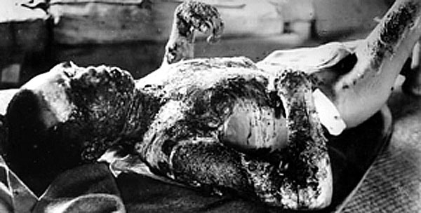
Atomic Bomb Victims

Slide 23
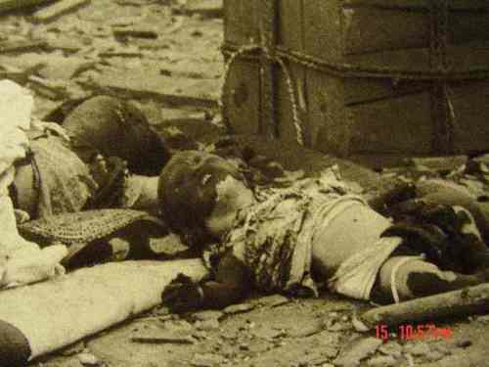
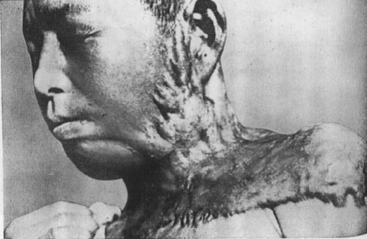
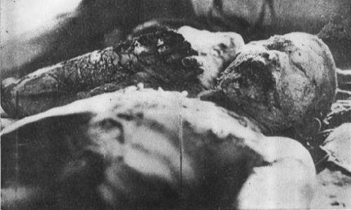
Atomic Bomb Victims

Slide 24
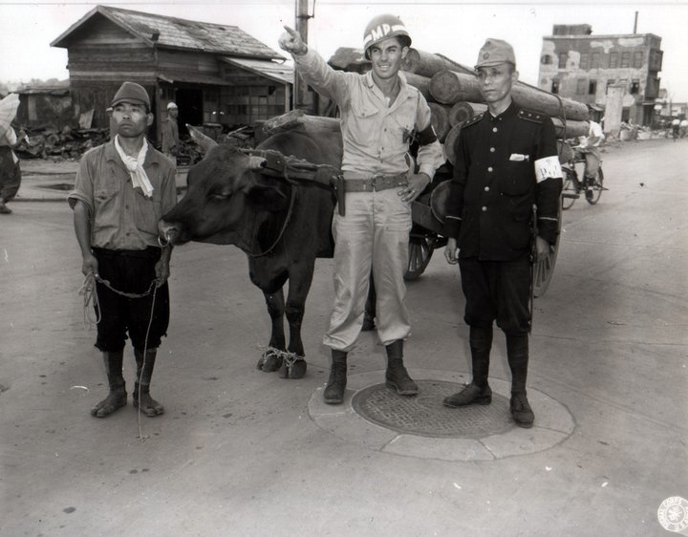
Occupation of Japan after WWII
U.S. forces occupied Japan after WWII from 1945 to 1952
Occupation led by General MacArthur
Democratic constitution imposed on Japan by the U.S.
Land, sea, and air forces = all disarmed
During the occupation – the U.S. sent over $2 billion in financial aid to Japan to help restore it

