Slide 1
The Roman Republic (509 – 44/27 BCE)
World History

Slide 2
Important Vocabulary
Republic | Roman Consul | Roman Senate | Term (politics) | Dictator
Patrician | Plebian | Tribune | Law of the Twelve Tables
Questions to Know Answers For
Why did Rome change from a monarchy to a republic?
What is the general governmental structure of the Roman Republic?
In what way do the Tribunes support the Plebeians?
How do the Roman Gods affect the daily lives of Romans?

Slide 3
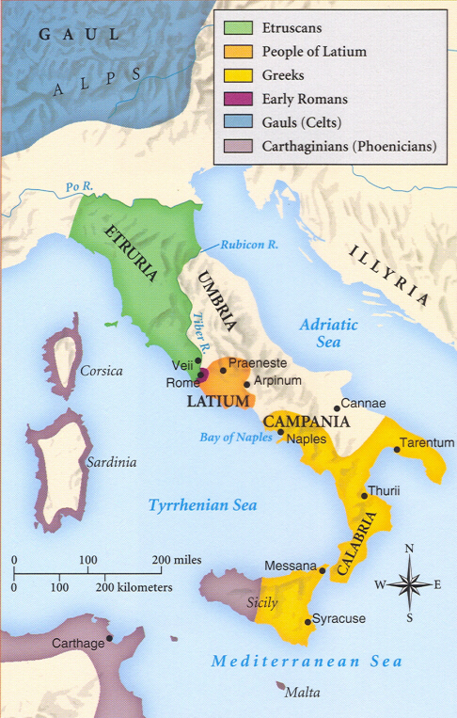
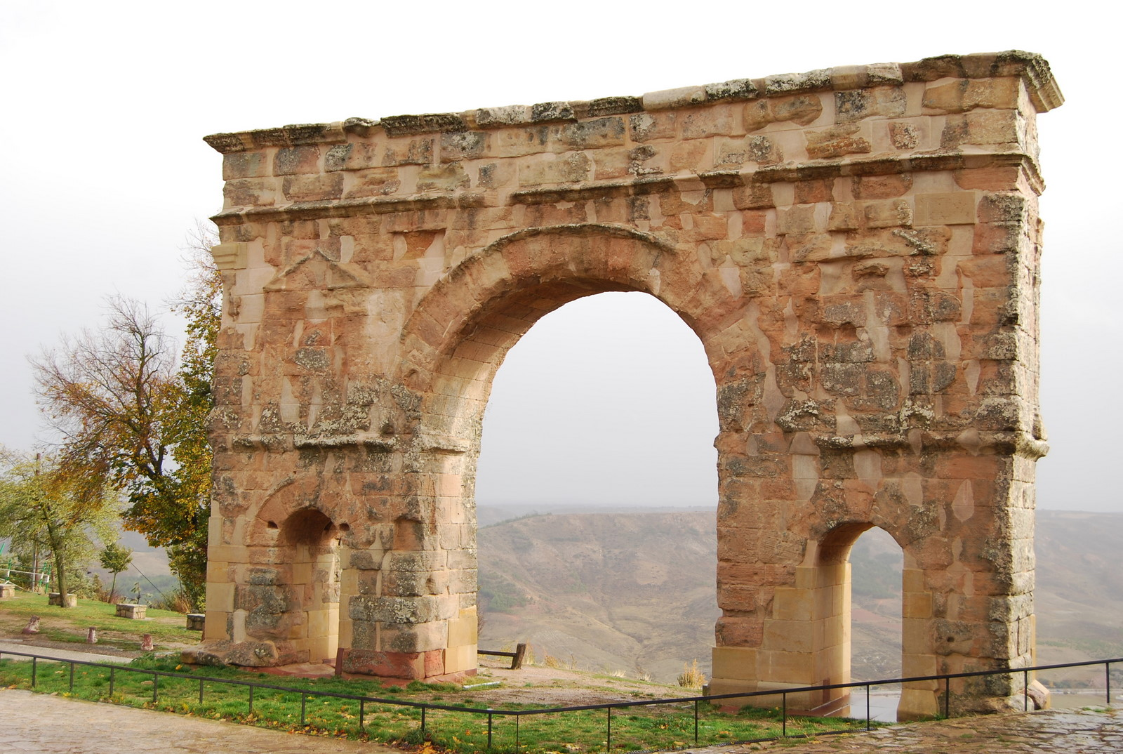
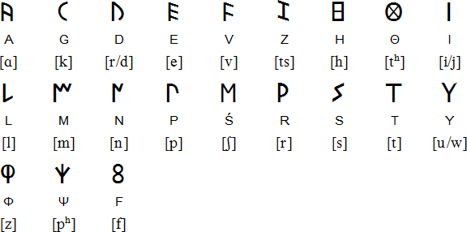
Etruscans, Latins, and Greeks
Etruscans lived in northern Italy
Had their own writing system & developed the archway design
Latins lived in central Italy
Origination of the mythical she-wolf character of the founding of Rome
The Greeks lived in southern Italy
Influence from Greek cultures

Slide 4
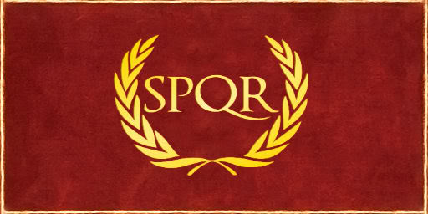
Formation of the Roman Republic
Rome was founded in 753BCE along the river Tiber
After a series of tyrannical kings, though, the people revolted and instituted a Republic rule instead in 509BCE
Republic:
A government where citizens vote for their leaders
In Rome, only free-born citizens could vote (no women, no slaves, no children)
Senatus PopulusQue Romanus
“The Roman Senate and It’s People”

Slide 5
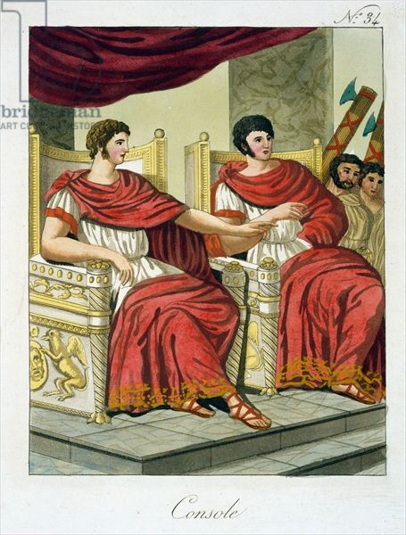
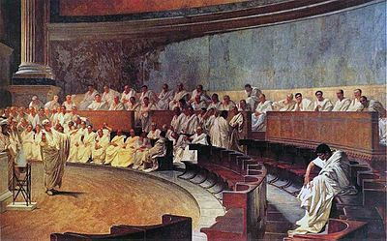
Governmental Structure of Roman Republic
What are the advantages and disadvantages of a one-year term for consuls?
Consul (x2)
Two elected leaders who serve one-year terms (and not again for another 10 years)
Made decisions for the Republic and was leader of the Roman military
Senate
300 members (only citizens of Rome) who serve for life
Worked on legislation and administration (creating and maintaining laws & gov’t)

Slide 6
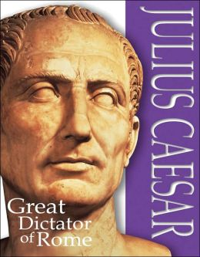
What happens in a time of crisis?
Dictator
A dictator has complete control of all of Rome for a period of 6-months to deal with the crisis
Dictator is chosen by the Consuls, and approved of by the Senate
Dictators were relatively common from 500-200BCE in the Roman Republic
Became Dictator in 49BCE

Slide 7
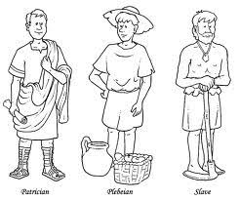
Inequality in the Roman Republic
Inequality exists in almost every society and civilization
Ex. Roman Citizens (no women, slaves, children)
Rome originally had ruling class families called Patricians
Patricians were typically of the wealthy class (aristocrats)
All other Roman citizens were Plebeians (commoners)
Originally, ONLY the Patricians could be Consuls and Senators
Why is this going to lead to a conflict?
What types of jobs did each class of people do?

Slide 8
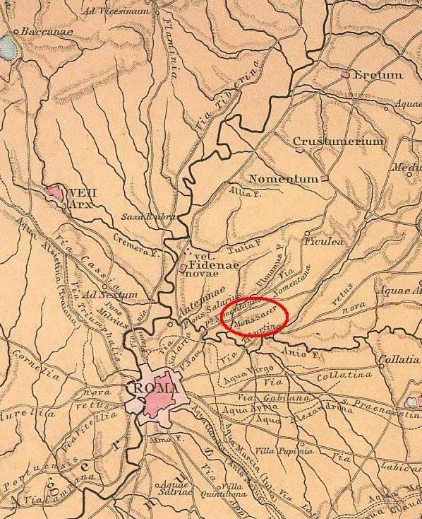
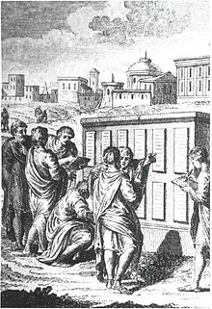
Conflict of the Orders
If the Plebeians were all of the laborers, artisans, farmers, and soldiers, what can they do disrupt the Republic?
In 494BCE, the Plebeians went on strike: they moved out of the city of Rome to Mons Sacer, a hilltop nearby
To get the Plebeians to come back:
Position of Tribune created (elected amongst the Plebeians and has veto rights against Consuls, magistrates, and other Tribunes)
Law of the Twelve Tables (450BCE) – code of laws subject to both Plebeians and Patricians

Slide 9
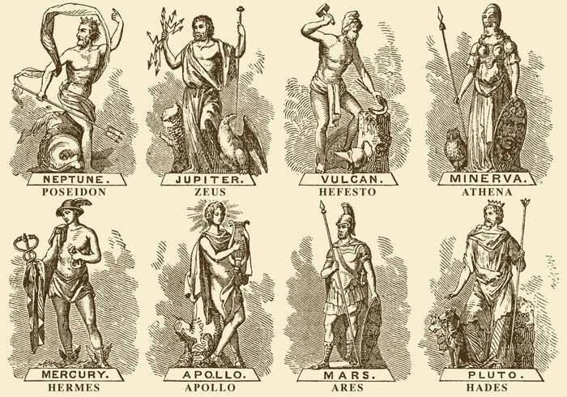
Roman (Greek?) Gods
The Romans essentially adopted the Greek influences, especially their gods
How might the following gods affect the daily lives of the Romans?
Cupid the God of Love
Mars the God of War
Vesta the Goddess of the Hearth
Minerva the Goddess of Wisdom

Slide 10
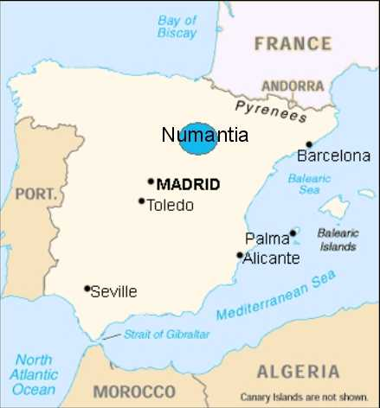
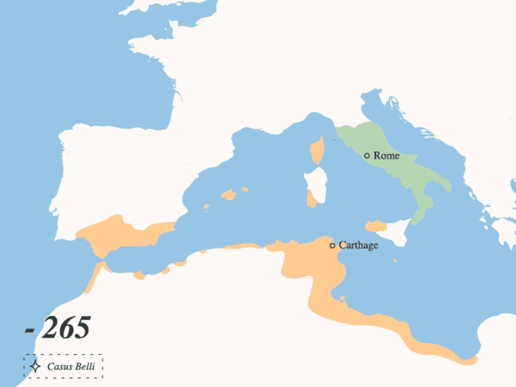
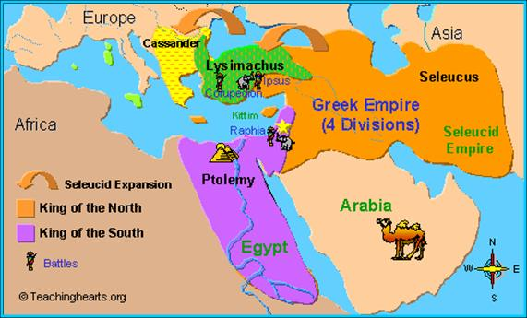
Roman Expansion (264-146)
Punic Wars (264 – 146BCE)
Series of three wars between the Roman Republic and the Carthaginians (Phoenicians)
Macedonian Wars (214 - 148BCE)
Series of wars between Roman Republic and the Greek Seleucid Kingdom
Numantine War (143 – 133BCE)
Rebellion amongst people of Numantia quelled by the Romans… but not before suffering defeat

Slide 11
Roman Military Structure

