Slide 1
The Roman Empire (27 BCE – 476/1443 CE)
World History

Slide 2
Important Vocabulary
Augustus Caesar | Pax Romana | Aqueducts | Latin | Christianity
Questions to Know Answers For
Who won the Roman Civil War?
Who is Augustus and why is he considered holy?
Who is the founder of Christianity?

Slide 3
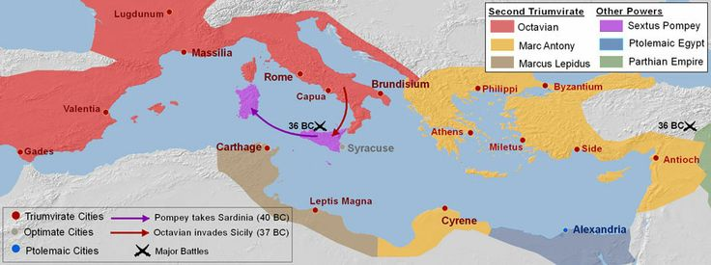
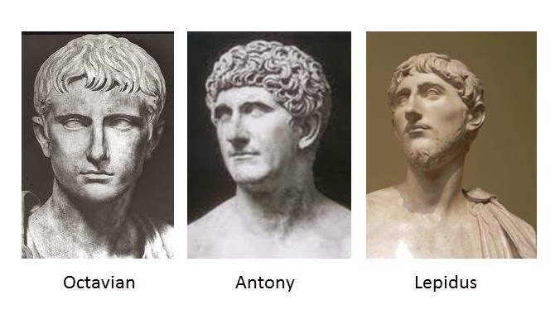
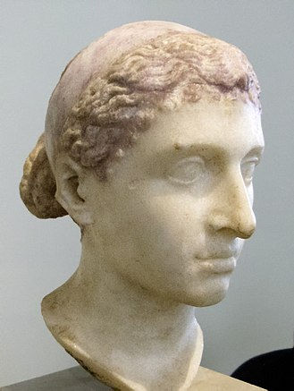
Liberator’s War (Roman Civil War) 43-43bce
The Second Triumvirate was successful in fighting against the forces of Julius Caesar’s assassins and win back all of Rome
Octavian (Julius’ grandnephew) conquers Italy and Europe
Marc Antony (Julius’ trusted war companion) allies with Cleopatra (ruler of Egypt) and conquers Greece and Turkey
Marcus Lepidus tries to hold North Africa, but is eventually rescued by Octavian
But, the Roman Empire doesn’t start until 27 BCE… what happens in between?
Cleopatra VII

Slide 4
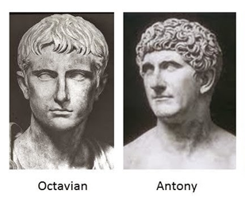
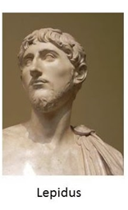
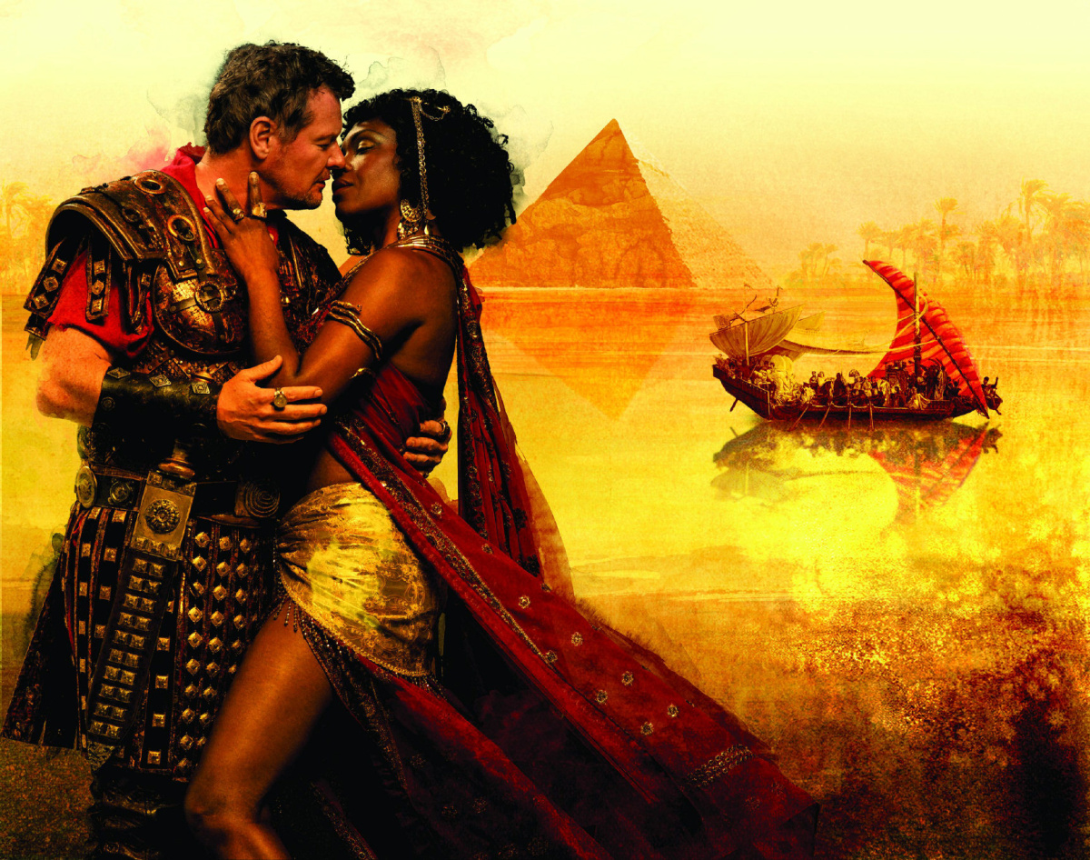
The End of the Second Triumvirate
VS
Marcus Lepidus
The people lose confidence in him due to his poor performance during the Liberator’s War
Marc Antony
After allying with Cleopatra, he stays in Egypt because he falls in love with her
Problem #1: He stays in Egypt instead of Rome
Problem #2: He is already married
Problem #3: He is married to Octavian’s sister
Problem #4: Cleopatra has a previous child with Julius Caesar
Why might Octavian be threatened by a child?

Slide 5
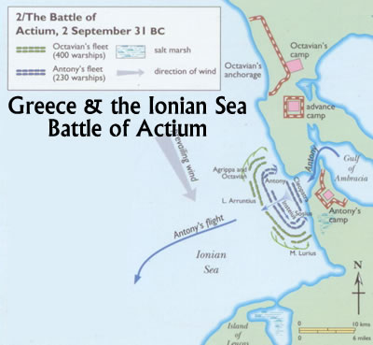
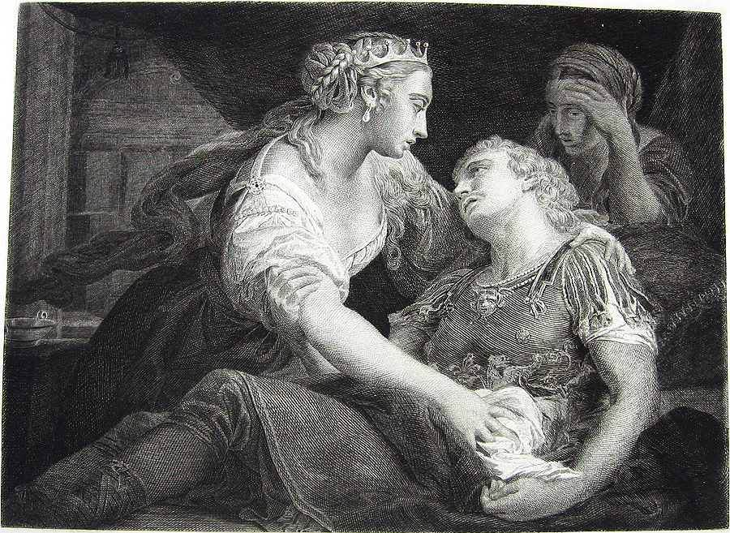
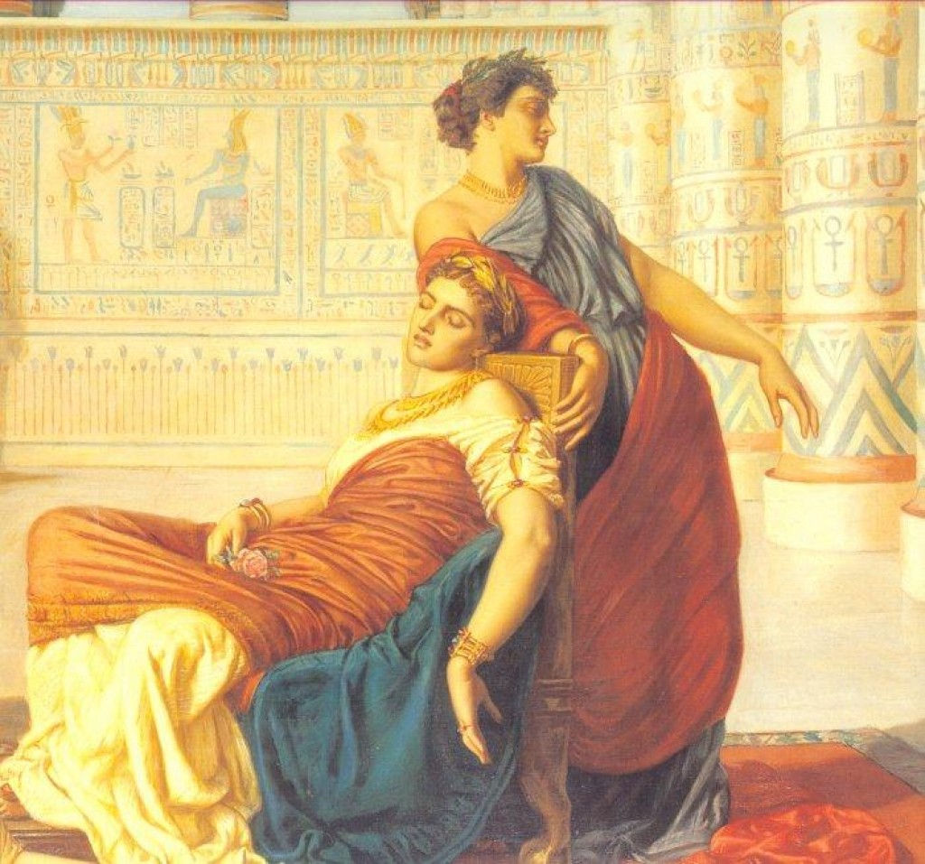
Final war of the Roman Republic (32-30BCE)
Octavian goes to war with Antony and Cleopatra
Antony loses a major battle in Greece and flees to Alexandria
Knowing the end is coming, Antony kills himself in the arms of his lover
Cleopatra then also kills herself
Octavian takes over Egypt and orders the execution of Cleopatra’s son, so that there can only be one Caesar
VS
Cleopatra VII

Slide 6
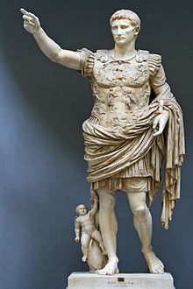
Roman Empire and PAX Romana
Octavian crowned as Emperor to the newly established Roman Empire in 27 BCE
Renamed and titled as Augustus, meaning “Majestic” or “Venerable” in Latin
The Pax Romana (27 BCE – 180 CE) is a period of ‘peace’ in the Roman Empire
The Roman Empire continues its conquests and expands

Slide 7
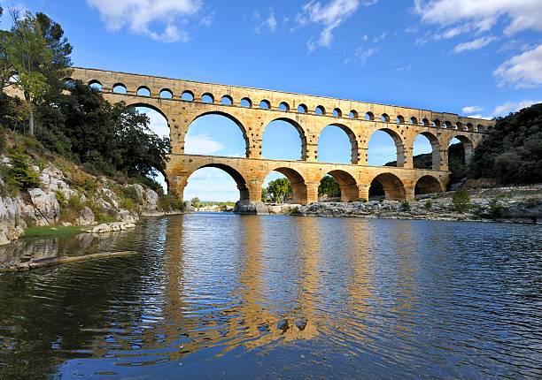
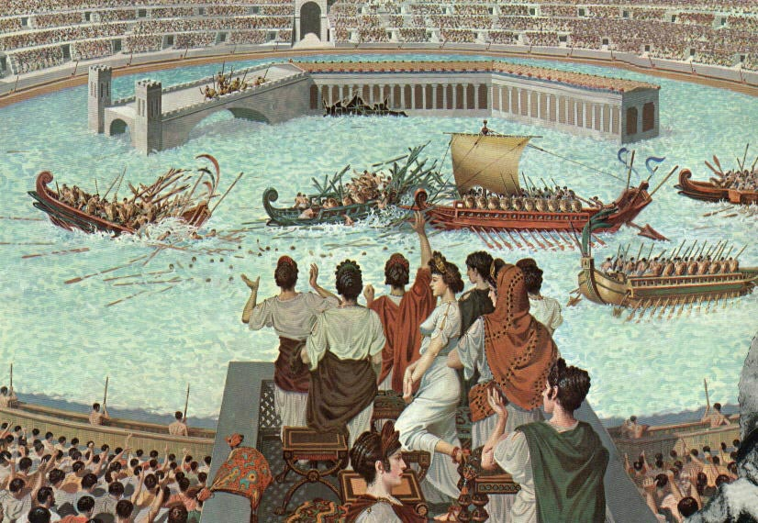
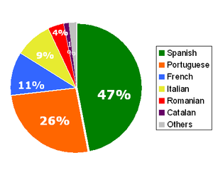
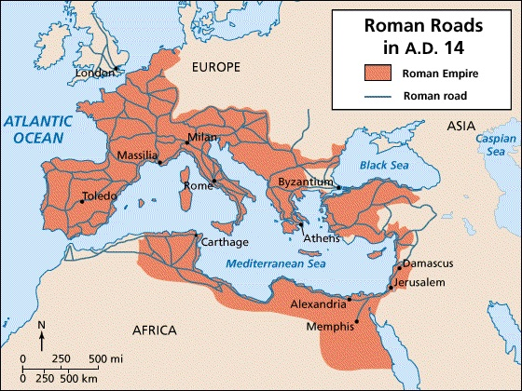
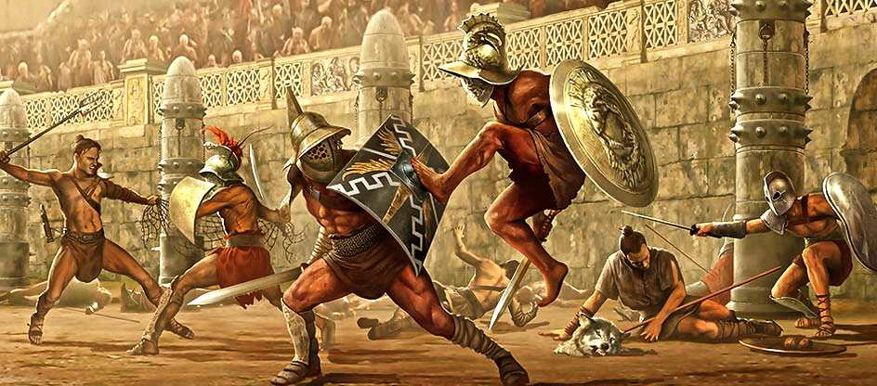
Roman Achievements and Influence
Many achievements of the Roman Empire
Aqueduct
Coliseum and gladiatorial games
Julian Calendar
Spread of Latin language
Romance Languages
Roads (“All roads lead to Rome”)

Slide 8
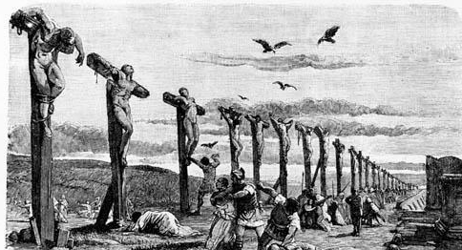
Spread of Christianity in the Roman Empire
Initially, Christianity was banned in the Roman Empire
Went against the Roman Gods
Challenged the power of the Emperor (Augustus stated he was descended from Venus)
Christians were thus persecuted
The Bible states that their messiah, Jesus, was crucified by the Romans
Jews were not persecuted because they didn’t proselytize (spread the religion)
Martyrdom of Christians actually pushed the growth of the religion
In 300 AD, Roman Emperor Constantine made Christianity the main religion of the Roman Empire

Slide 9
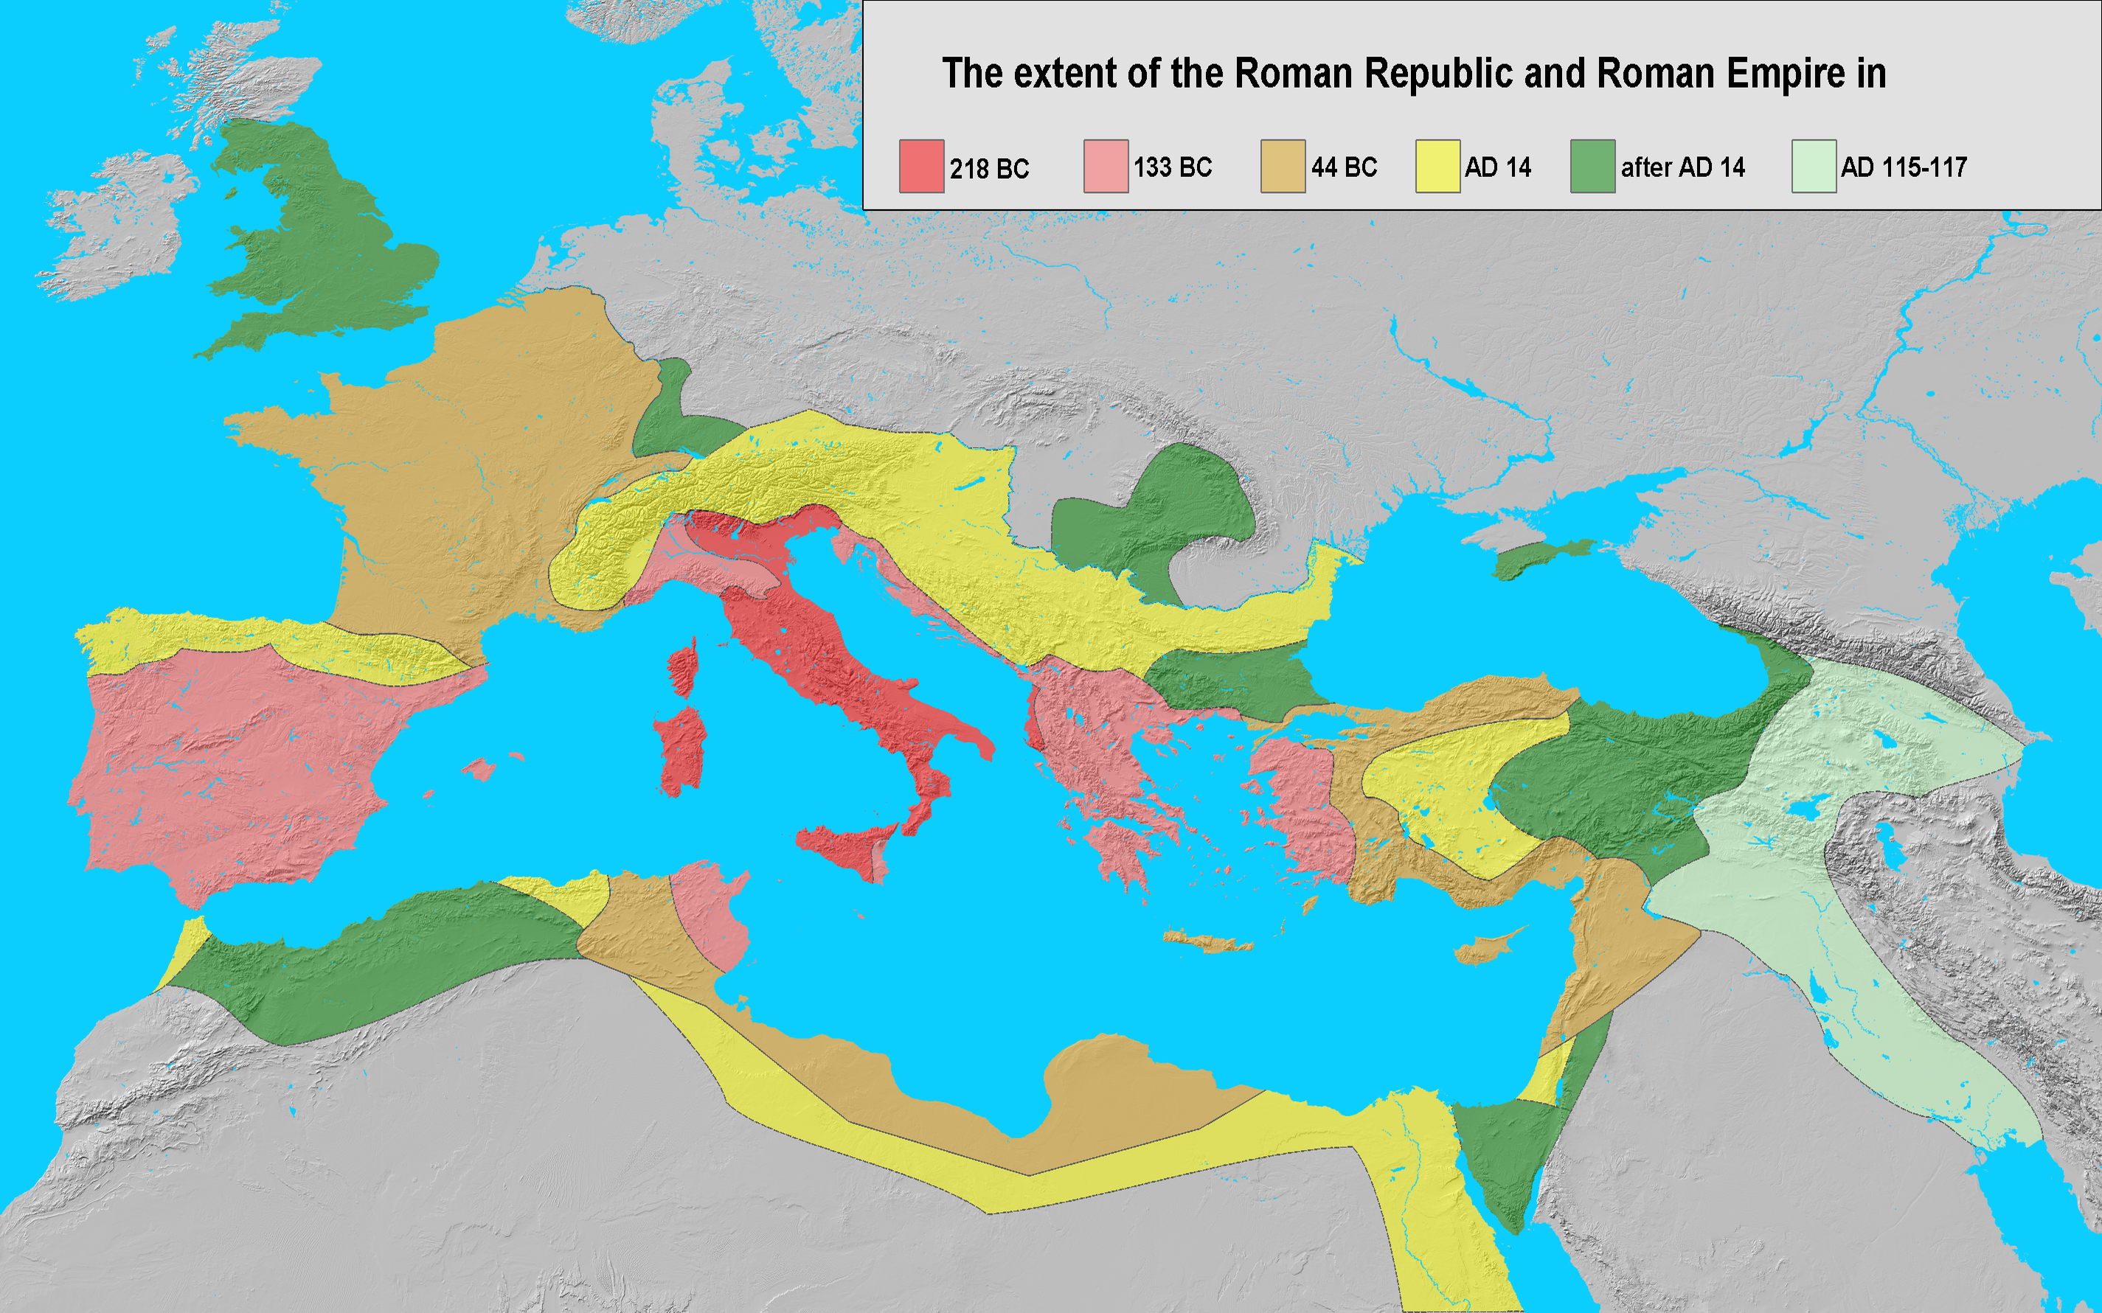
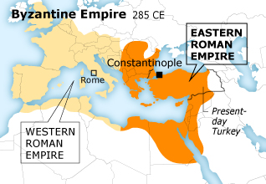
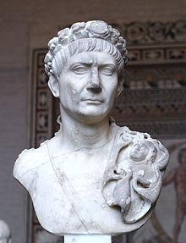
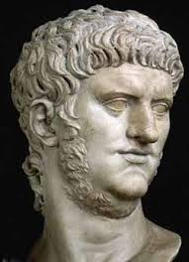
Various Roman Emperors and the Split
Various Roman Emperors throughout the history of the Empire
Some great
… and some not so great
The Roman Empire became too large and hard to control from just one location and just one Emperor
In 285, Emperor Diocletian partitioned the empire into two pieces: The Eastern Roman Empire with Constantinople (formerly Byzantium) as the capital and the Western Roman Empire with Rome as the capital
Emperor Trajan
(98-117 AD) – Expanded the Empire to the largest its ever been and built many public works. Trajan’s Column still stands
Emperor Nero
(37-68 AD) – Blamed the Christians for the Great Fire of Rome, killed his own mother, and was deemed, “Enemy of the state” by the Senate

Slide 10
The End(?) of The Roman Empire
Roman Empire Decline
Split of the Empire (East/West) made it harder to control evenly
Eastern Roman Empire didn’t care much for the problems of the West and vice-versa
Various internal and external struggles
Central and Eastern European tribes attacked the outer Empire & Attila the Hun came close to invading Italy
Power struggles and internal politics divided the country
The Gauls sacked Rome in 390 CE
In 476 CE, Germanic peoples capture Rome and expel the last Western Roman Emperor
Eastern Roman Empire continues, though, until 1453 CE

