Slide 1
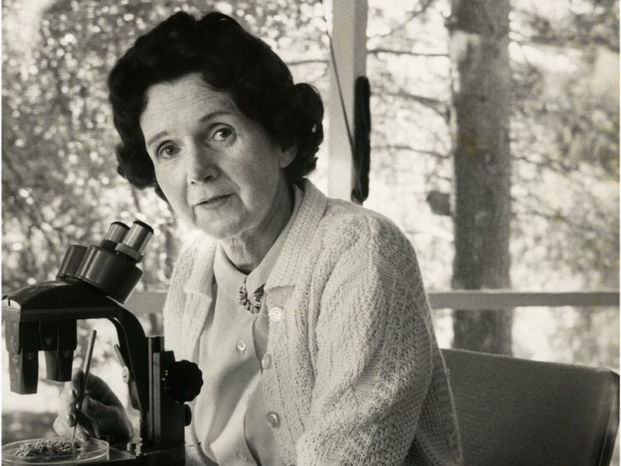
Rachel Carson
Biologist
Conservationist
Writer

Slide 2
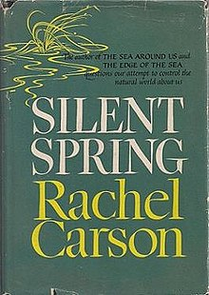
Who was she?
Carson was a famous biologist and writer
Wrote Silent Spring in 1962
  The book was critical of the use of chemical pesticides
  Both data driven and emotional appeal
  Started the American environmentalist movement

Slide 3
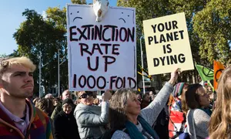

Significance & Legacy
The book caused controversy
  Progress vs. Nature
Environmental activitism
Resulted in the creation of the Environmental Protection Agency in the US
Banning of specific types of pesticides (DDT)

