Slide 1
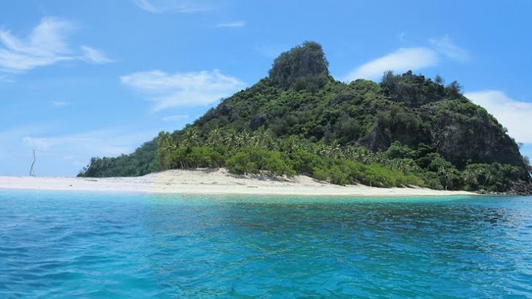
Pegasus Island

Slide 2
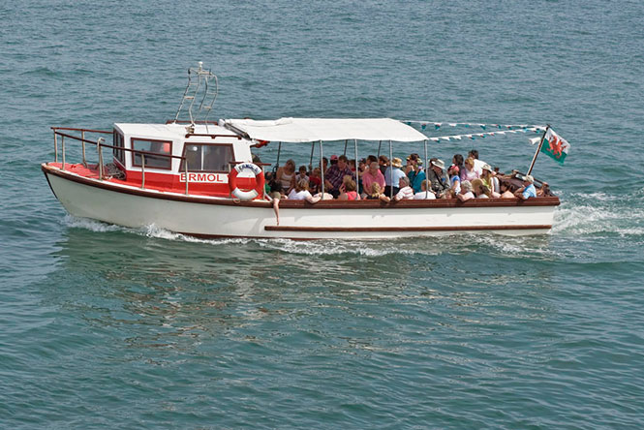
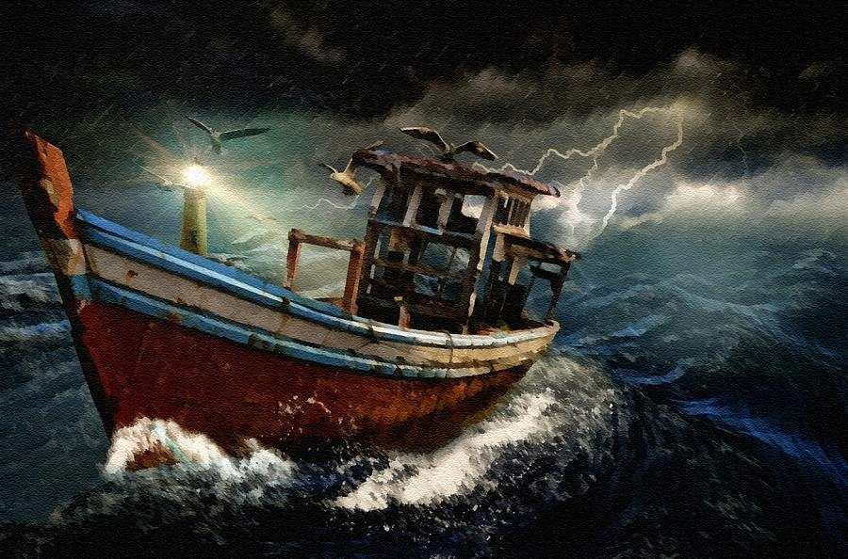

Slide 3
You awake on an island with your classmates
Everyone is by the beach area
Wreckage from the ship all around
Some rations, but only for 1-2 days
The Island
The island is not charted on any map
Tropical climate
Dense jungle inland
Tall peak mountain
2km x 2km wide
No cell reception
Decide what you must do in the next (days, months, years)

Slide 4
On an A4 piece of paper…
Write your name on top-right of paper
Answer the questions in complete sentences
What was the first thing the group decided to do? Did you believe it to be the right decision?
Was there a leader of the group or were decisions made equally? Did you listen to other or did you tell people what to do?
Would you have done anything differently from what the group had done?
If yes, what would you have done instead?
If no, why do you believe these to be the right decisions?

