Slide 1
Notecards, Reading, and Note-Taking
An AP World History Guide

Slide 2
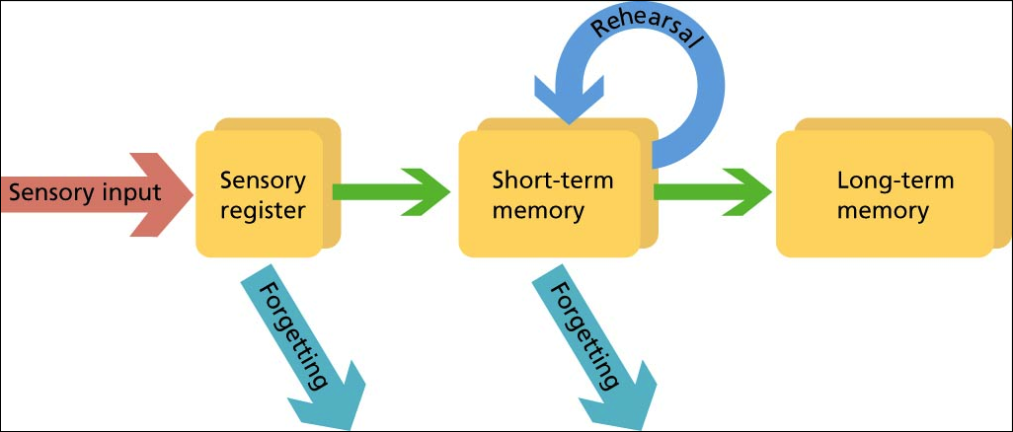
Notecard Guide
Why Notecards?
  Notecards help with familiarizing with the subject and keeping it fresh over a long period of time (short-term memory > long-term memory)

Slide 3


Notecard Guide
DO NOT MEMORIZE
  Memorization doesn’t help. Instead, create connections
Students who do well on notecards, review/study them, and take them seriously tend to do well on the AP Exam

Slide 4
Notecard Guide
(Front of Card)
Concept or Phrase
Where in the text it came from
Identifier
(Back of Card)
Complete thought that corresponds to Concept/Phrase
Definition (use power verbs if possible)
Lists significance (general and historical)
Analyzes significance

Slide 5
Notecard Guide
Uruk
Chapter 2, pg. 69
Period 1/Ancient
Ancient Mesopotamia’s largest city in 3000BCE
Described in the Epic of Gilgamesh
Is an example of an early, largely developed city post-Neolithic
Associated with the Fertile Crescent region (Tigris-Euphrates River Valley)

Slide 6
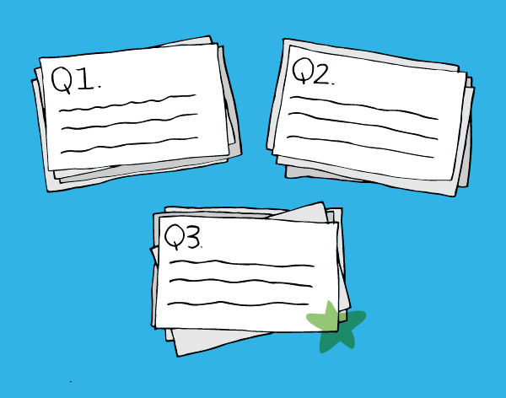
Notecard Guide
Study in piles
  Pile 1: Cards you immediately recognize and can immediately answer
  Pile 2: Cards you recognize eventually and can answer eventually
  Pile 3: Cards you do no recognize
Reshuffle pile 2&3 and start over again
  Goal: Try to get all cards to Pile 1
  When complete, move onto another set of cards

Slide 7

Notecard Guide
DO NOT USE NOTECARDS FOR MORE THAN 15-MINs AT A TIME
  Take a break and do something different for 30mins
  Make sure to come back to them, though

Slide 8

Textbook Reading Guide
How should you read the textbook?
Browse: Look through the chapter
  Read the headings of chapters, sections, and sub-sections
  Read and look at all maps, drawings, paintings, graphs, and charts
  Quick glance (15-20mins)

Slide 9
Textbook Reading Guide
How should you read the textbook?
Skim-and-Scan
  Read the opening remarks of the chapter
  Read the first paragraph of each section and sub-section
  Find the thesis for the chapter and section
  Read the first sentence of every other paragraph
  Read the captions to the maps, graphs, etc.
  (30-45mins)

Slide 10
Textbook Reading Guide
How should you read the textbook?
Careful Reading
  Read the chapter from start to finish
  Carefully read every sentence and word
  Re-read all captions
  Spend time reading the chapter
  Do it in 1-2 sittings
  (1-3hrs)
RECOGNIZE: No Notetaking should be occurring yet!

Slide 11
NoteTaking Using Synthesis
Write Chapter # and Title at the top
  Skip a few lines
Write Section Title
  Skip a few lines
Write Sub-section Title
  Skim subsection and synthesize 1 sentence summary of this sub-section
Synthesize for all sub-sections
Use Sub-section synthesis to summarize Section in 1 sentence
Use Section synthesis to summarize Chapter in 1 sentence

