Slide 1
AP World History
Pegasus California School

Slide 2
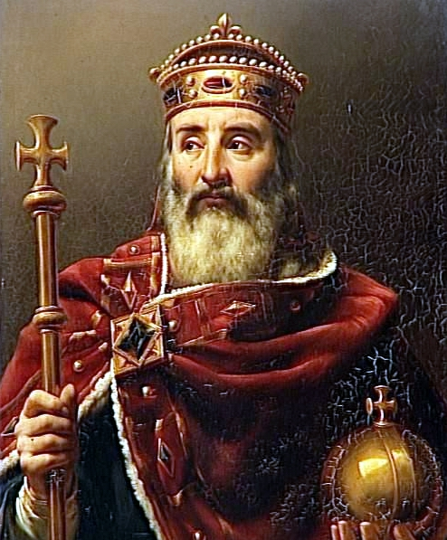
Agenda
Notes
European Middle Ages (500-1500)
  Charlemagne and the Germanic Kingdoms
  Invaders of Western Europe
  Age of Chivalry
  Power of the Catholic Church

Slide 3
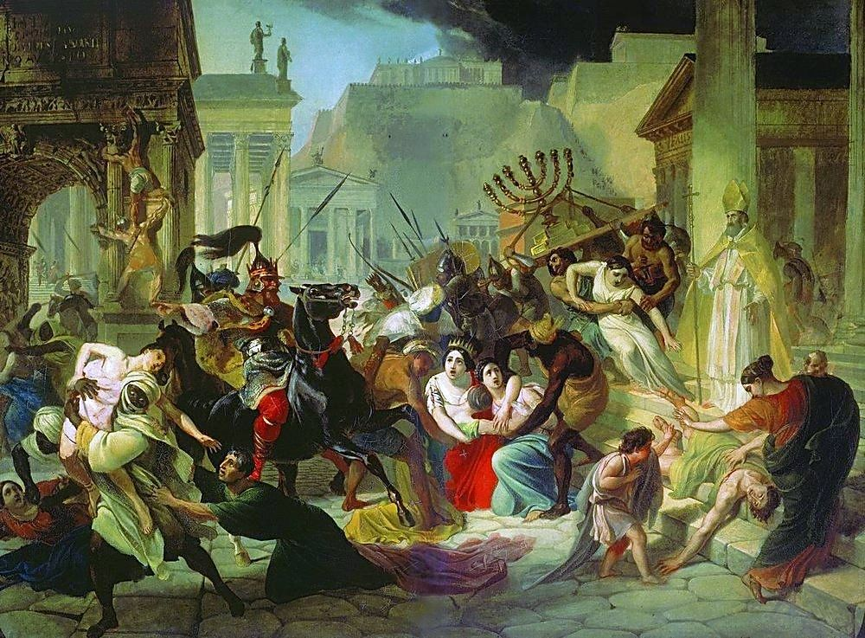
Where did we last leave off with the Western Roman Empire?
Germanic tribes sacked Rome in 410 CE
  Visigoth and Vandals had been attacking the city
  It was a symbolic end of the Roman Empire
  Rome was looted but many of the structures were still left intact
  The only stabilizing organization was the Catholic Church

Slide 4
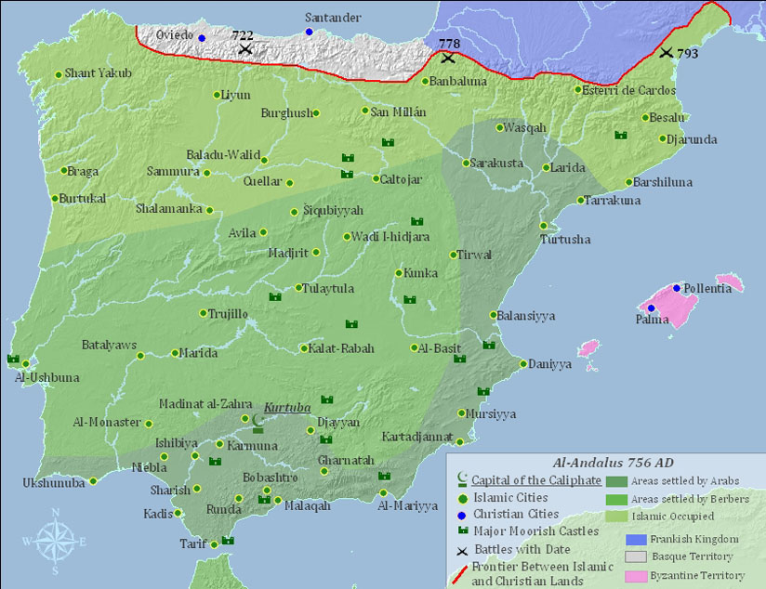
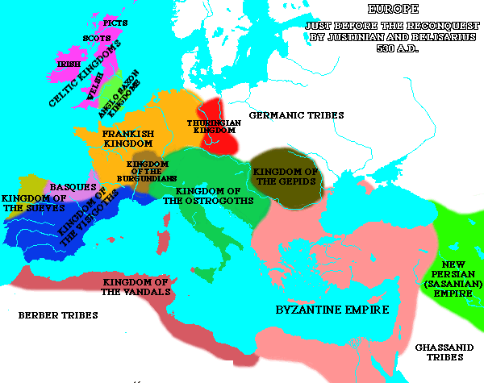
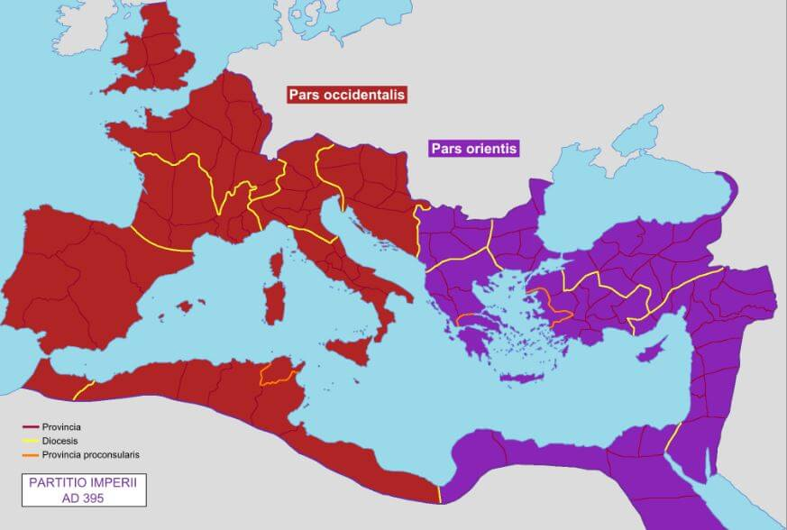
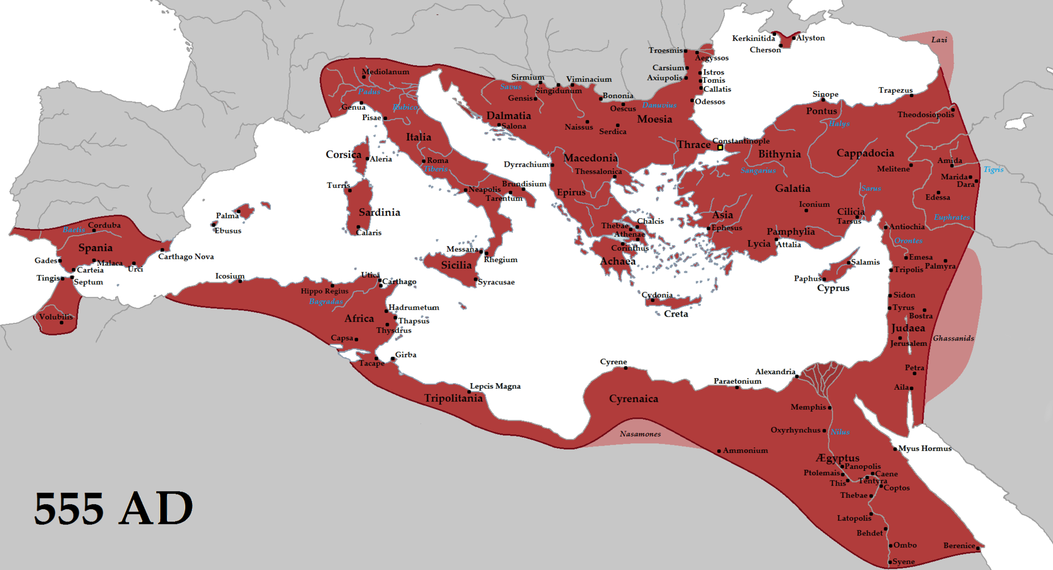
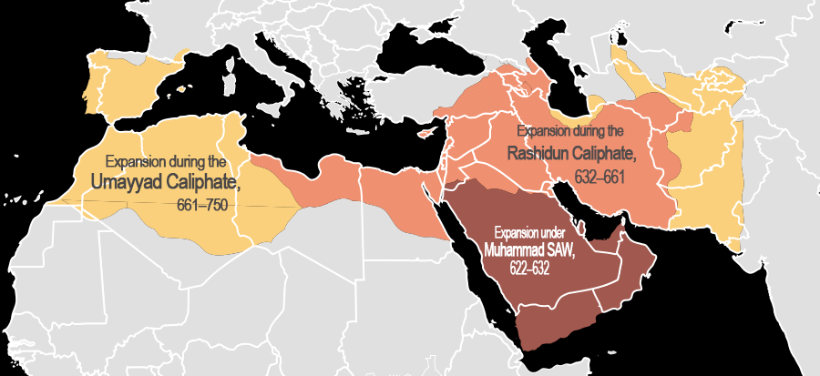
The Move towards Feudalism
Peoples from the major cities spread to the countryside
  Place like Rome were no longer considered safe
No loyalty to Emperor or Kings
  Local lords with fiefdoms (lands) became the leaders of local areas and constantly fought one another for dominance

Slide 5
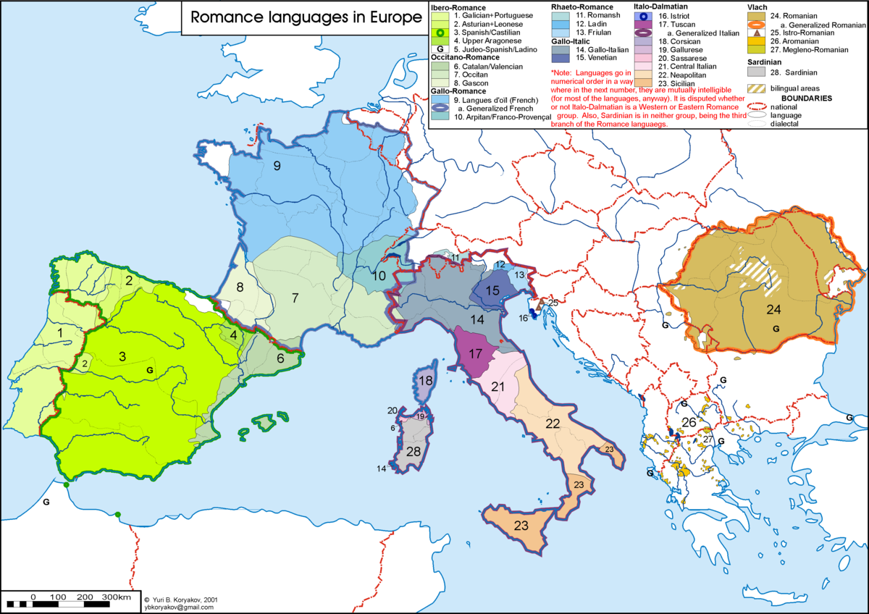
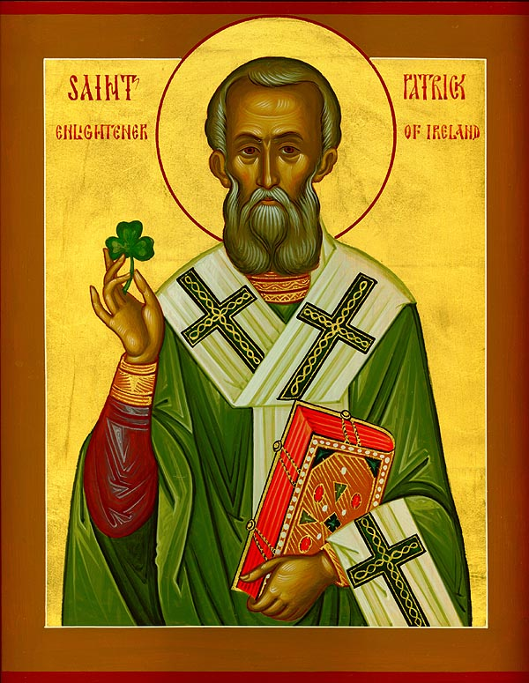
The Spread
French Word | Latin Word
Feminin | Femininus
Papier | Papyrus
Peche | Persicum
As people spread everywhere, religion and language also spread as well
  Monasteries were built around various places in Europe as place where Christians could worship
    Monks and Nuns devoted themselves to the Church
    Were often the centers of education in the local area
  Latin evolved into the various Romance languages (French, Spanish, Portuguese, Italian, etc.)
Spanish Word | Latin Word
Disccionario | Dictio
Escuela | Schola
Bueno | Bonus

Slide 6
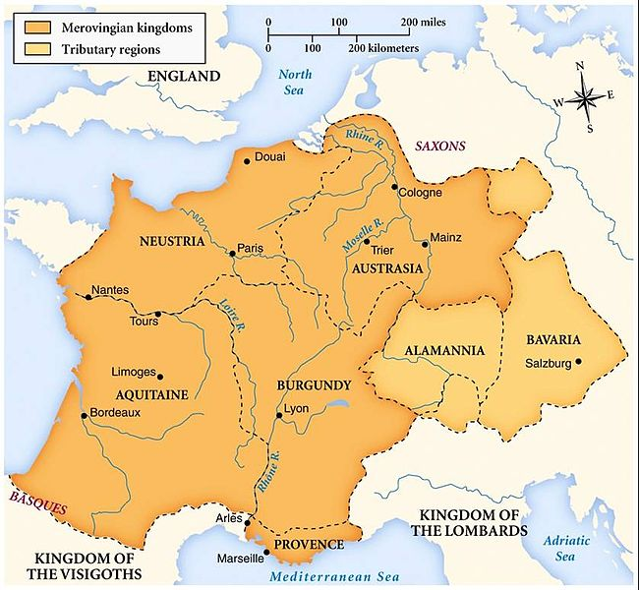
Rise of the Franks
The Franks inhabited the territory of the Gauls, the “barbarians” that the Roman Empire fought during the rise of Rome
  Territory included present-day France and Switzerland
Clovis, the leader of the Franks, institutes Christianity as the religion of the land in 511CE

Slide 7
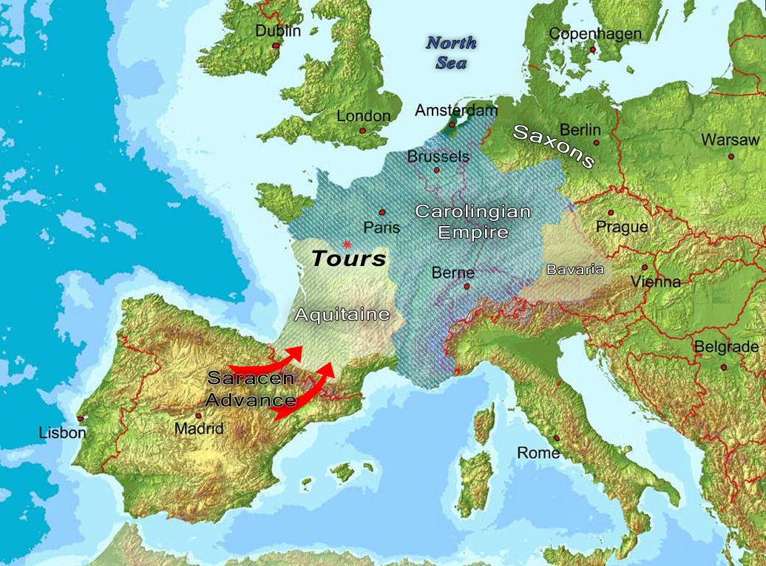
Charles the Hammer and the Battle of Tours
In 732 CE, the leader of the Franks, Charles Martel, defeated the Muslim army at the Battle of Tours
  Prevented Muslim Empires in Spain from moving further east towards the rest of Europe

Slide 8
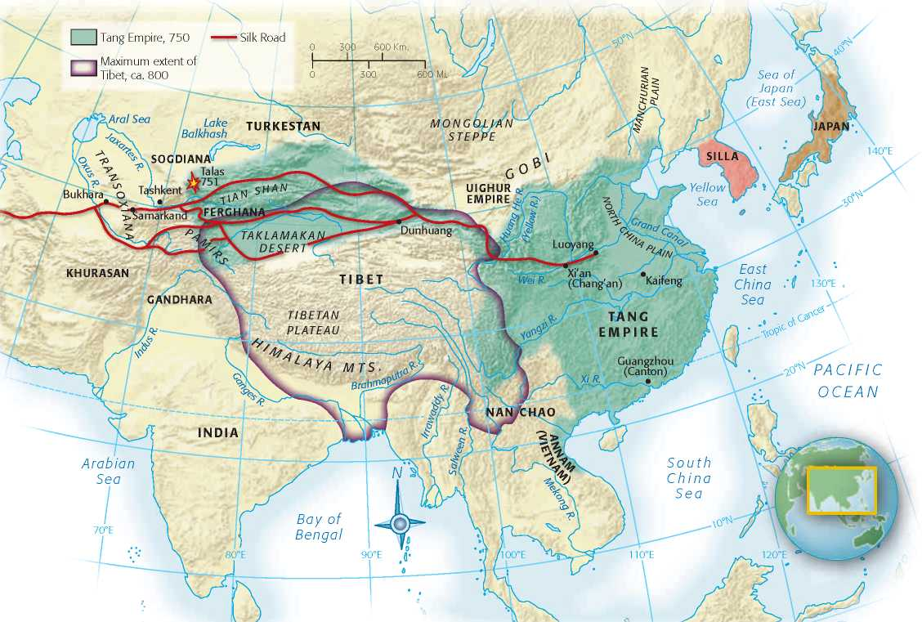
On the other side of Eurasia…

Slide 9
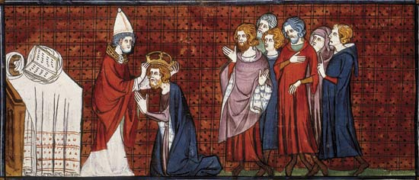
Charlemagne
Grandson of Charles the Hammer (established the Carolingian Dynasty)
  Helped to spread the territory further than Charles Martel
Charlemagne saves Pope Leo III
  Pope was accused to scandals and barely escapes being beaten to death
  Asked for help from Charlemagne and was escorted back to Rome
Charlemagne gets crowned Emperor in 800CE
  Death of Charlemagne leads to a split in lands and once again, feudalism

Slide 10
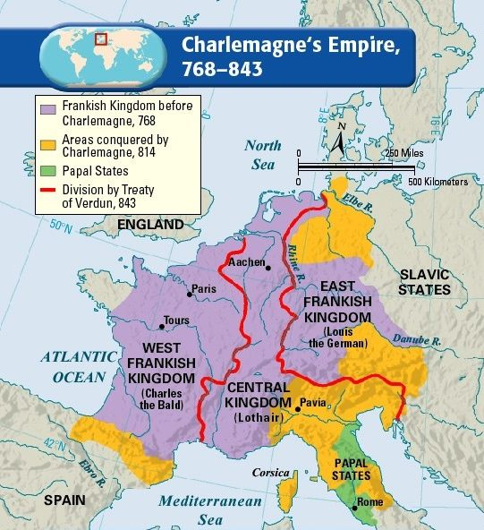

Slide 11
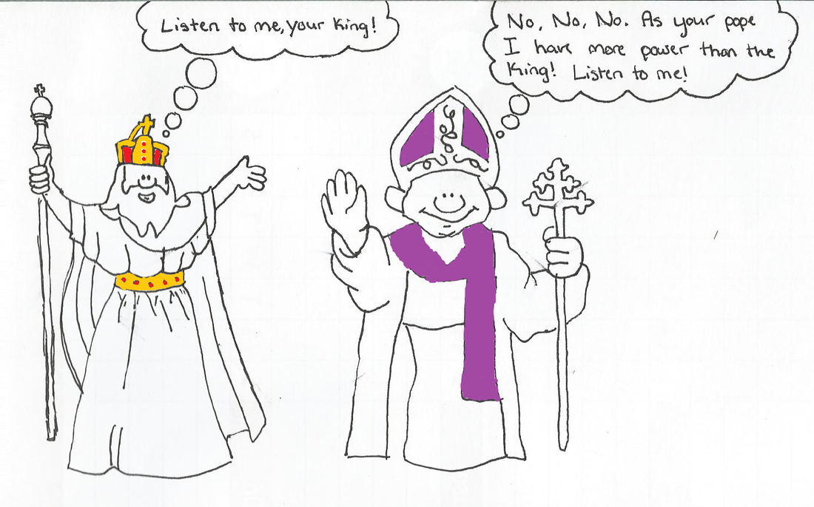
Spiritual vs. Physical Rule
Who do you believe has more authority on the people in Western Europe at the time?
  Church or Emperor/Kings?
Originally, it was believed that matters of the spiritual and of the physical should be kept separate
  Church = Spiritual Authority
  Emperor/Kings = Physical Authority

Slide 12
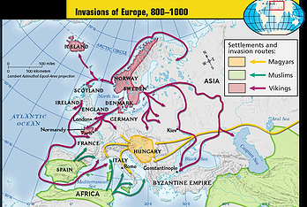
Meanwhile, Invasions on Europe (700-1000)
Vikings from the north (Scandinavia)
  Colder climates pushed Viking peoples to plunder and raid European villages and cities
  Invasion via the Rhine and Seine rivers
Magyar and Muslims
  Magyars invaded from the East and sacked territories of present-day France
  Abbasid Muslims conquered from the south, attacking from Spain and tip of Italy

Slide 13
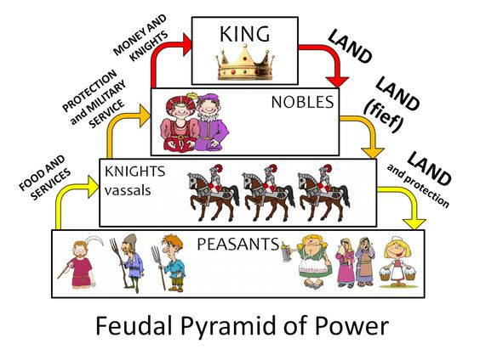
Further Feudalism
Lords grant Fiefs (lands) to Vassals (nobles and bishops) for loyalty
  Vassals grant land to Knights for protection
  Serfs (Peasants) work the land and labor for the knights, vassals, and lords for the right to live and work in the land under protection
    Serfs are contractually tied to the land

Slide 14
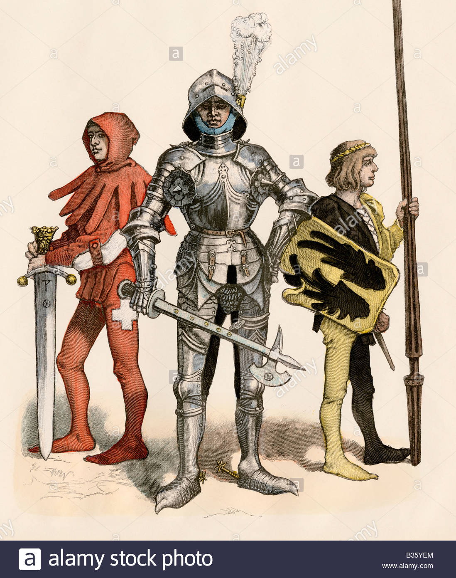
A Knights Tale
Knights were the warrior class that defended the Kings/Lords/Vassals
Requirements for Knighthood
  Had to be born into that class
  Training
    Knights start as a Page at age 7
    Promoted to Squire
    Became a knight at age 21

Slide 15
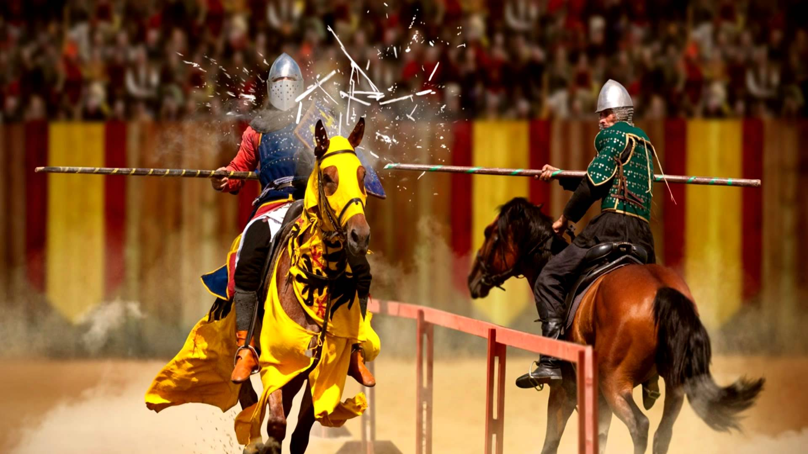
A Knights Tale
Knights had to train constantly as there were constant threat from outside invaders and other kingdoms
  Tournaments were held as tests and entertainment

Slide 16
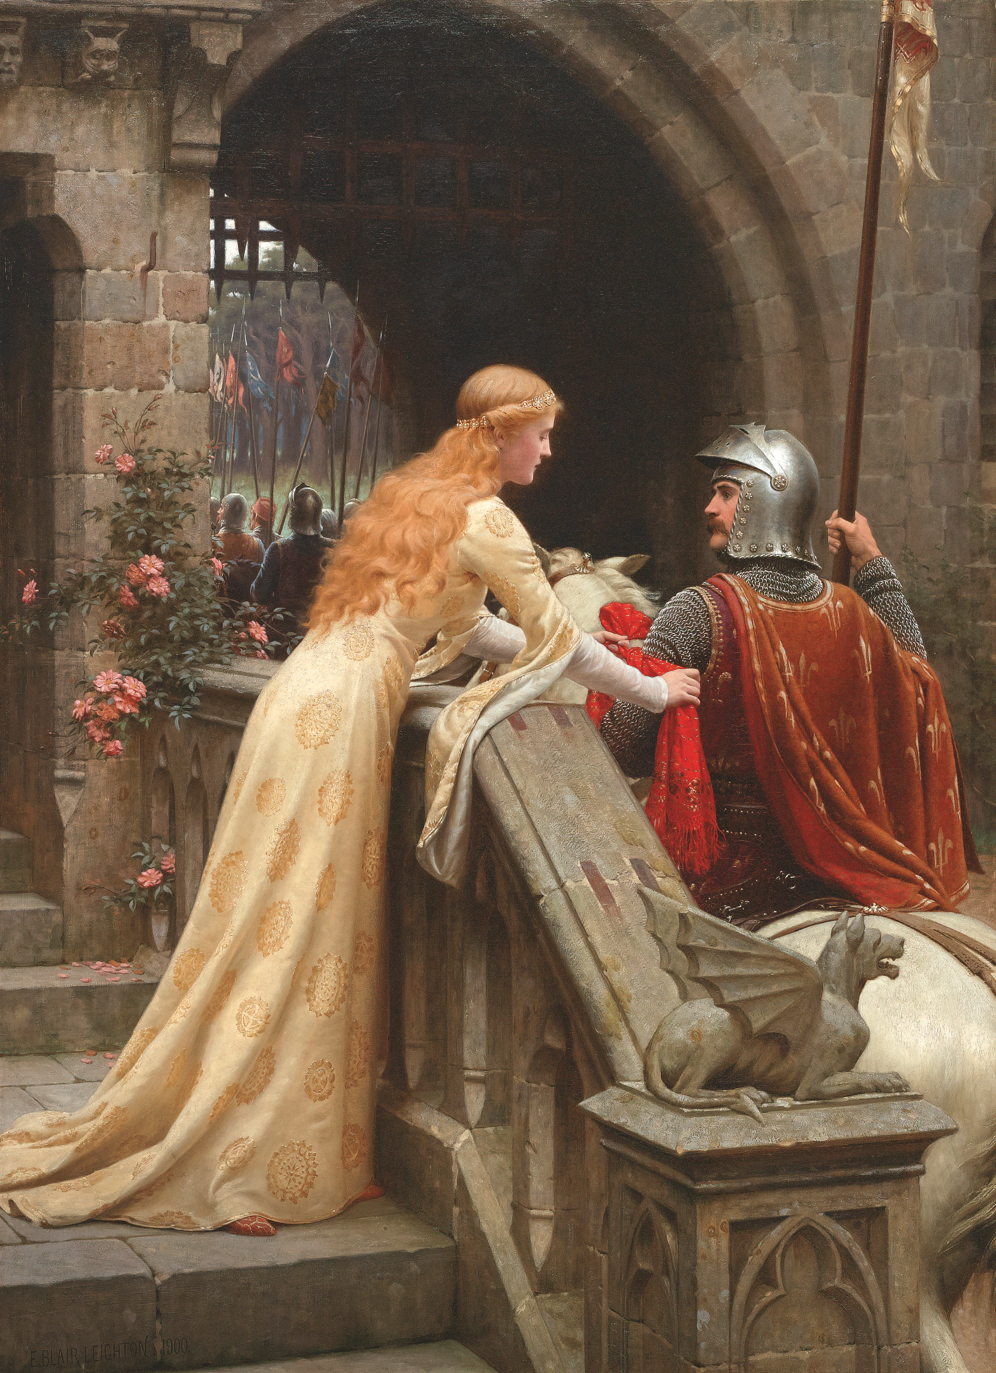
A Knights Tale
The knights (like the samurai) were subject to a discipline code
  Best to give rules to a warrior class… they know how to kill
Chivalry – Devote oneself to the three L’s:
  Lord of the Land
  The Heavenly Lord
  One’s Lady
No doubt, there was a certain romance to knighthood and chivalry
  We see these depicted by stories like King Arthur and The Song of Roland

Slide 17
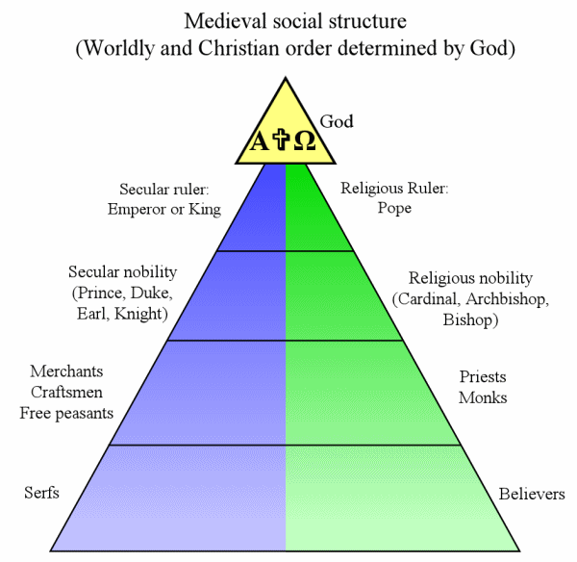
Power of the Church
The power of the Roman Catholic Church continues to grow during the medieval age
Medieval Social Structure:
  God
  Pope
  Clergy
    Cardinals, Bishops
    Priests, Monks
  Believers

Slide 18
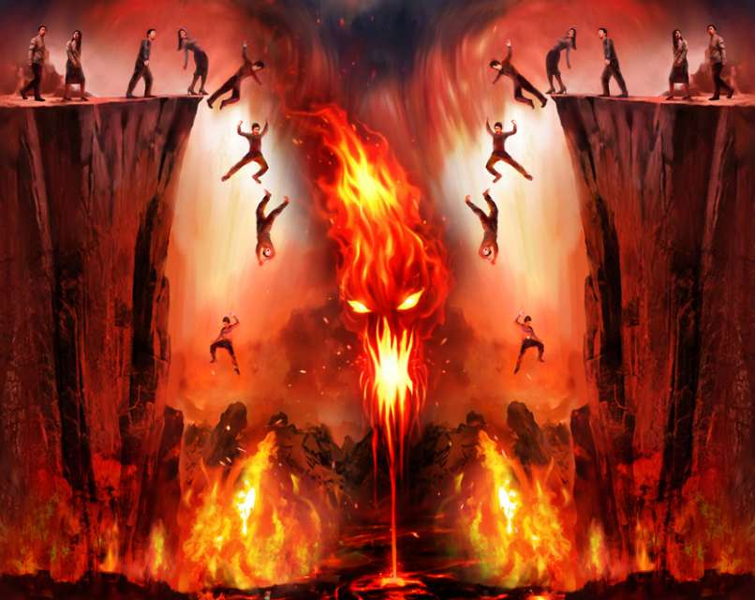
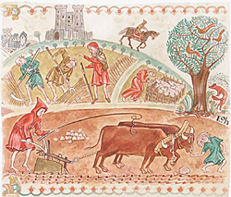
Power of the Church
All believers have to follow Canon Law (laws of the Church)
What happens if you don’t follow religious law?
As a believer, it’s scary enough to be told you’re going hell when you die but it’s worse if you’re higher on the social order

Slide 19
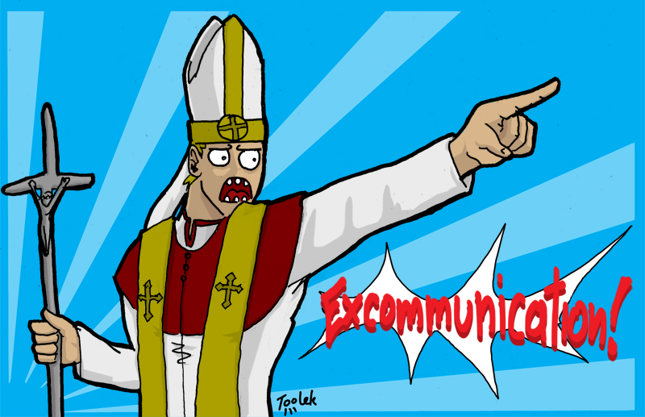

Two Punishments
Excommunication: banishment from the church
  Vassals of a lord who has been excommunicated have no obligation to lord anymore and would likely leave
Interdiction: religious services could not be performed
  Lands owned by a lord would not receive religious services (in essence, damning everyone who lived on the land to hell)

Slide 20
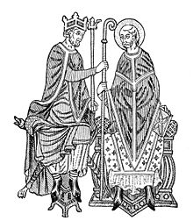
Conflicts Between Church and Secular Rule
Secular (worldly) rule and the Church often clashed
Lay Investiture
  Kings and nobles believed that they could appoint the Bishops
In 1075, Pope Gregory VII banned Lay Investiture
  Henry IV was angry and stated that Gregory should step down as pope

Slide 21
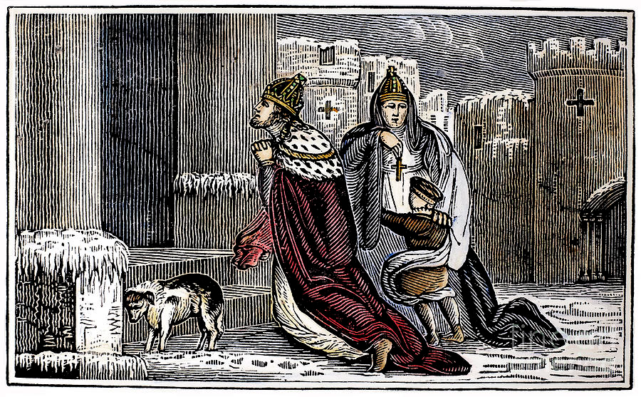
Henry IV Excommunicated
Henry begged outside of the castle the Pope stayed at to be released from excommunication
Supposedly waited three days in the snow

Slide 22
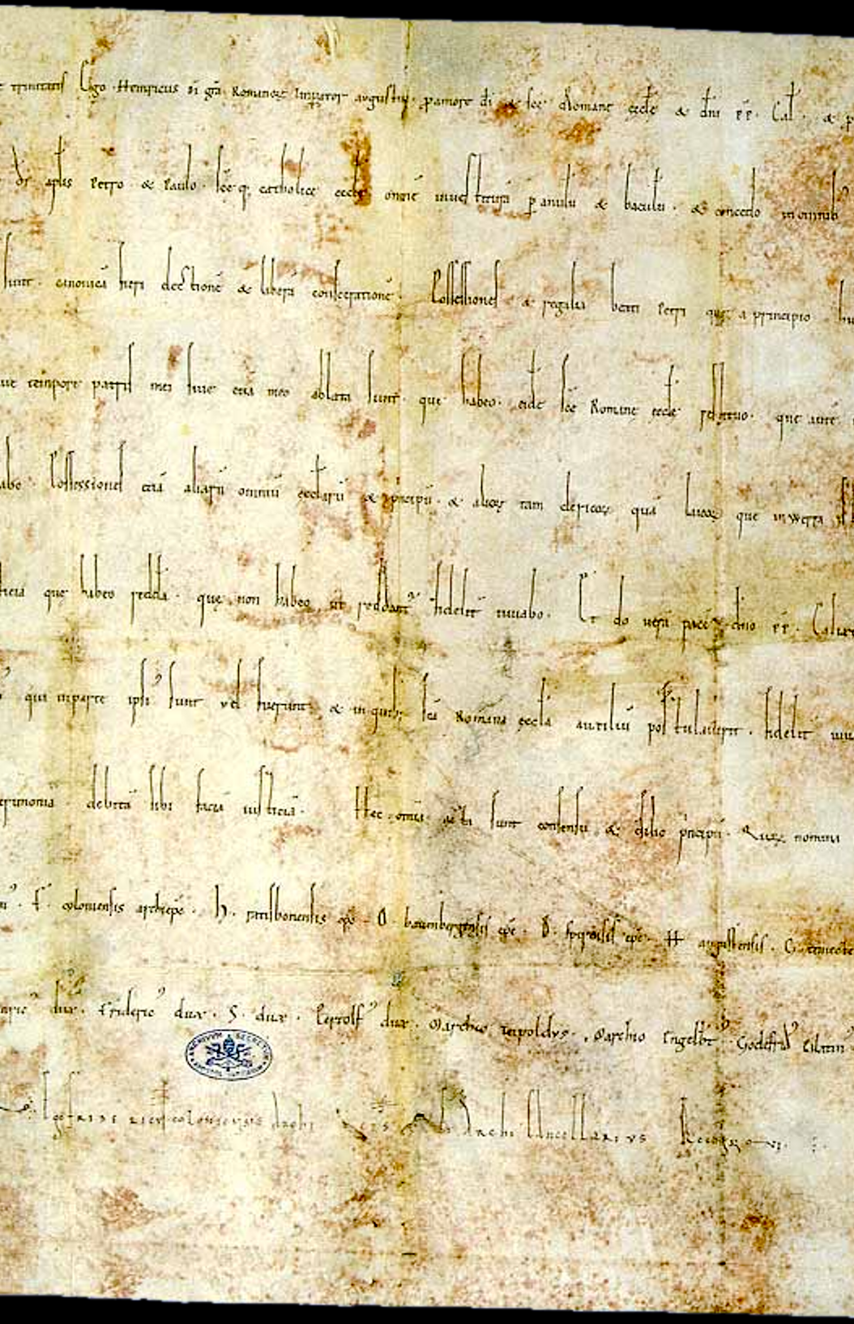
Concordat of Worms (1122)
Agreement between secular leaders and church that only the Pope can appoint bishops, but that the Emperor could veto
However, conflicts between the church and the secular rulers will continue

Slide 23
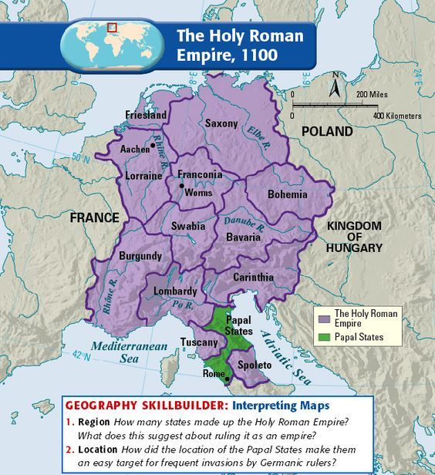

Slide 24
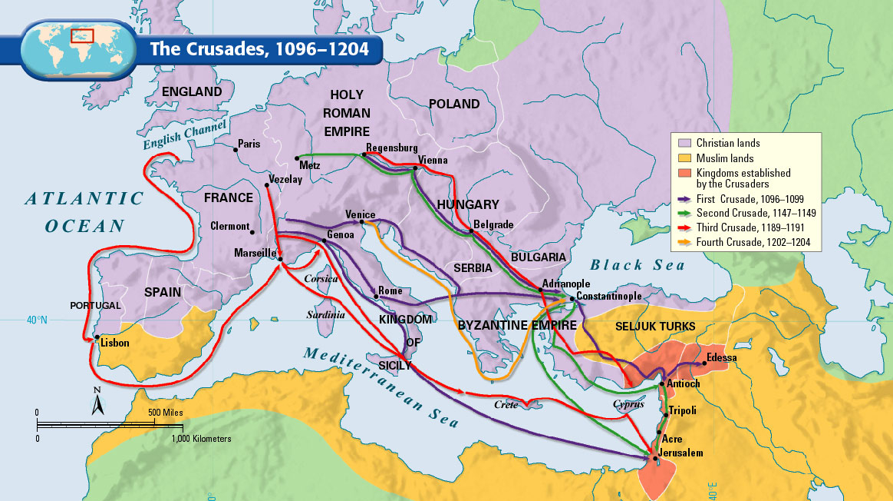

Slide 25
