Slide 1
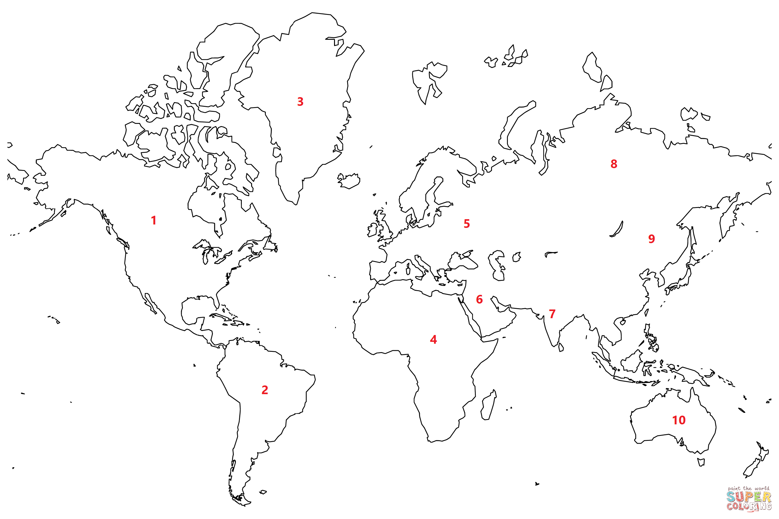
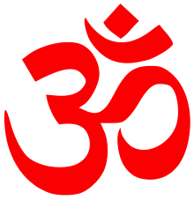
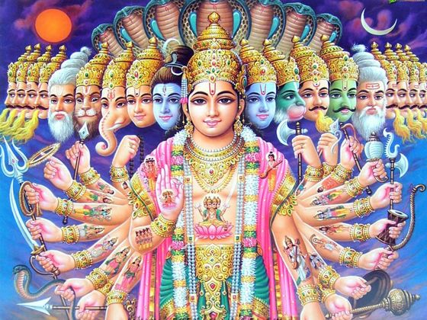
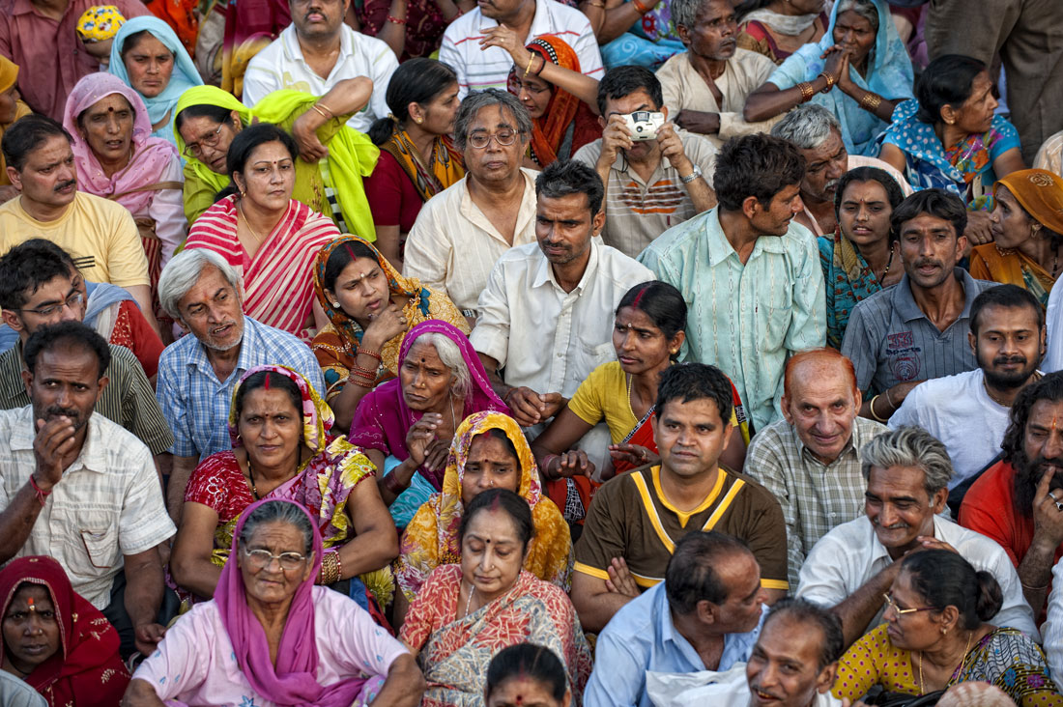
Hinduism
Followers:
Hindus
Adjective:
Hindu (ex. “Hindu book”)
Origin:
5000 BCE, India
Mono/Poly/Non-Theistic?
Many, Many Gods!
# of Followers today:
1 billion followers
The ‘Om’ as Symbol

Slide 2
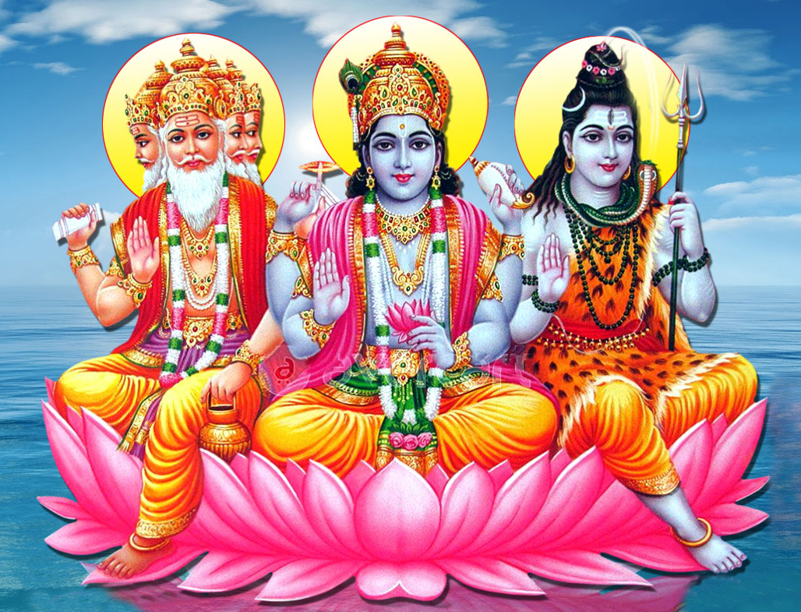
Hindu Deities
The Trimurti:
Brahma – the creator god
Vishnu – the preserver/protector
Shiva – Patron god of yoga, arts, and meditation; also known as the destroyer

Slide 3
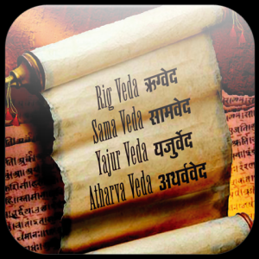
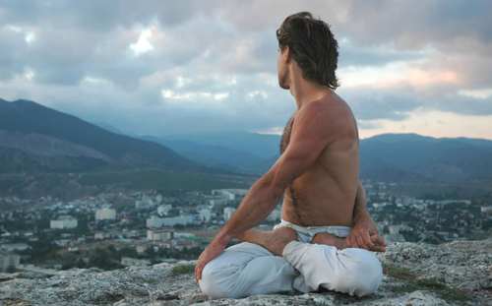
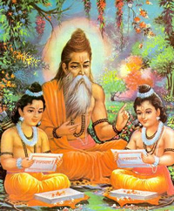
Hinduism - Philosophy
Vedas
Sacred writings. Includes four which goes over prayers, hymns, ritual rules, and spells
The Rig Veda mentions yoga as a practice of Hinduism
It has a meditative and spiritual core
Focuses on both physical and mental strength building
How to Read the Vedas?
The Upanishads was a book written around 600BCE
Written as a dialog between teacher and student

Slide 4
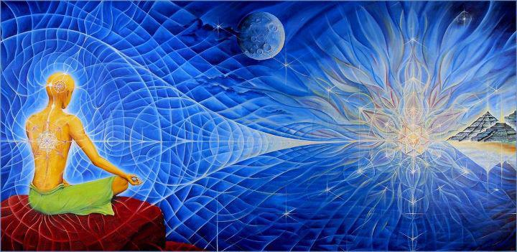
Hinduism - Terms
Atman: Your own soul
Brahman: The soul of every thing in the universe and the universe itself
Moksha: Perfect understanding of the relationship between one’s Atman and the Brahman; the end of the cycle

Slide 5
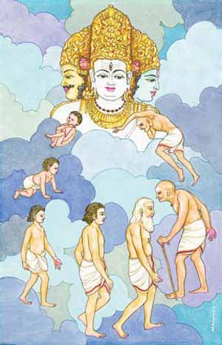
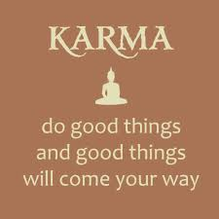
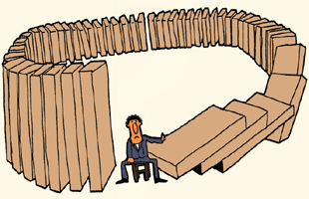
Hinduism - Terms
Samsara: The cycle of reincarnation
Reincarnation: Every living thing has a soul. When a living thing dies, it’s Atman moves to a new life to live again
Karma: Good or bad ‘points’ that determine where your Atman goes after death
Dharma: Rules determining good/bad Karma

Slide 6
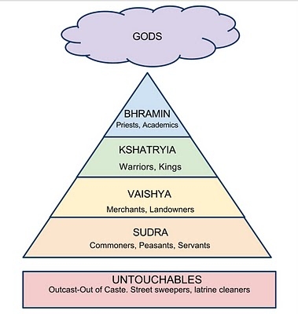
Indian Caste System
Your karmic deeds determine where you go after Samsara
Mostly Good Karma
Mostly Bad Karma
Why does religion benefit those in power?

Slide 7
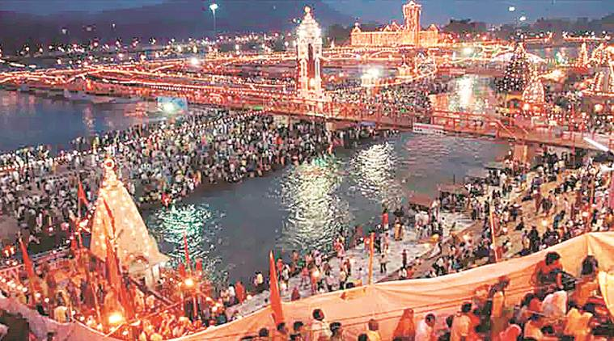
Pilgrimages
Hindus practice their faith by making a Pilgrimage (travelling to holy sites)
The Kumbh Mela are festivals that are held every three years in different locations
Followers bathe in the sacred/holy rivers of the Ganges, the Yamuna, the Godavari, and the Shipra

