Slide 1
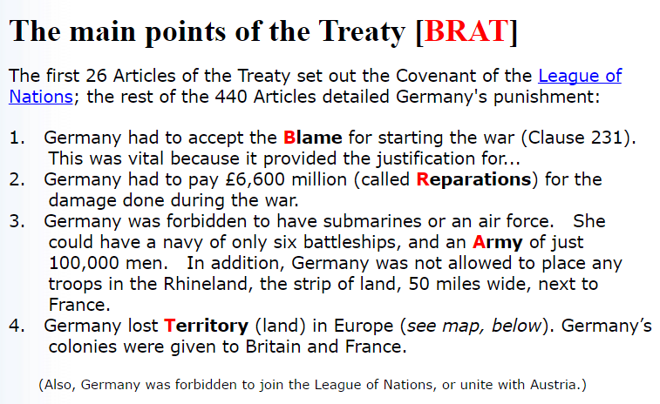
Germany’s Provisions Post WWI
Notes:
http://www.johndclare.net/peace_treaties4.htm

Slide 2
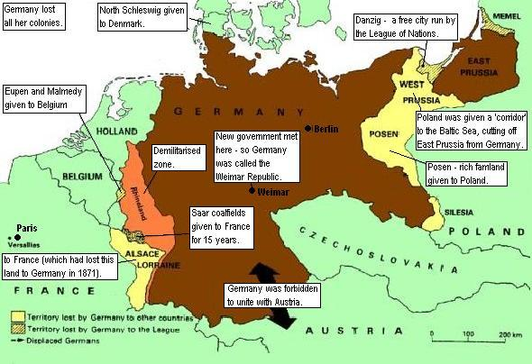

Slide 3
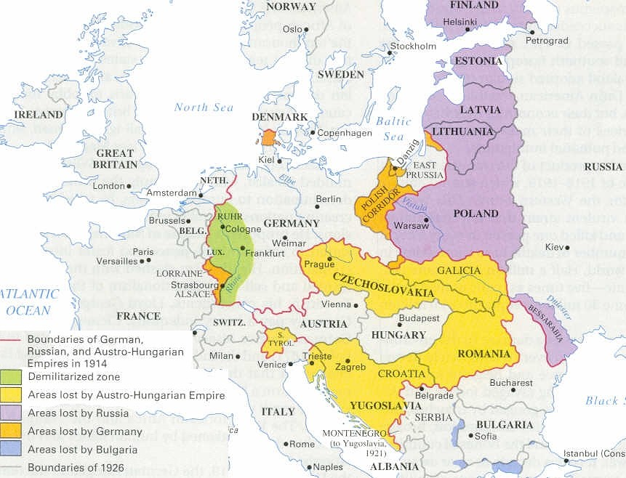
Europe after the Great War

Slide 4
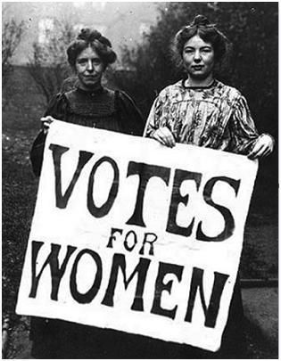
Social Changes of the 1920s
Class distinctions faded away as role of aristocracy declined
Government expansion led to expansion of “white-collar” jobs
  Advancements in technology prevented growth of working class
Women earned the right to vote

Slide 5
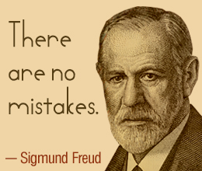
Scientific Revolution
Albert Einstein and Werner Heisenberg challenged traditional ideas of the universe
  “Truth was merely a set of mental constructs”
  Atomic world replaces classical world
Sigmund Freud
  Psychoanalysis was the key to understanding human behavior

Slide 6
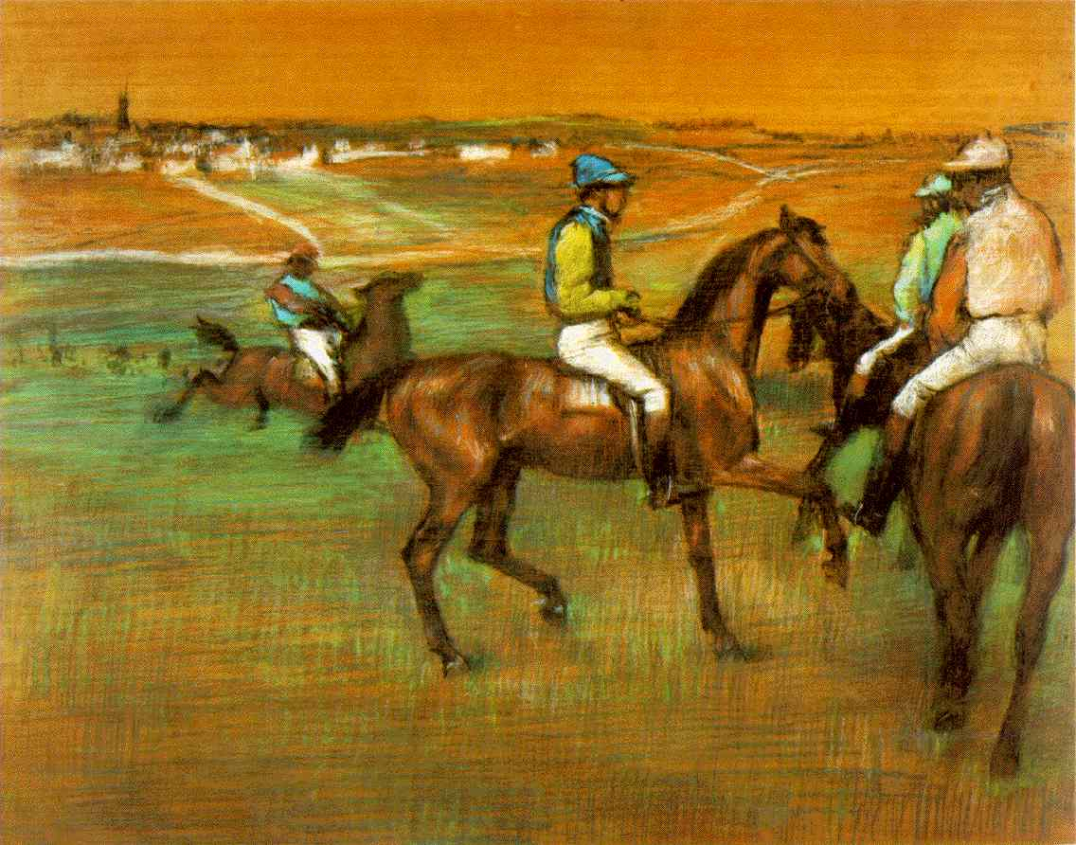

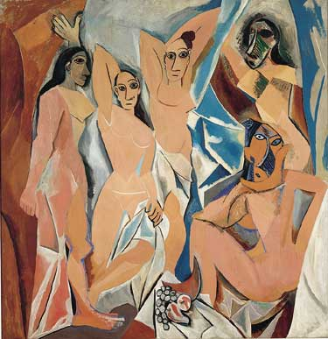
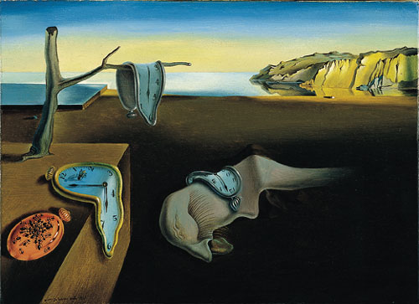

Artistic Revolution
Race Horses by Degas
Literature
  Ernest Hemmingway
  John Steinbeck
  F. Scott Fitzgerald
Art
  Edgar Degas
  Pablo Picasso
  Salvador Dali
Les Demoiselles d’ Avignon by Picasso
The Persistence of Memory by Dali

Slide 7
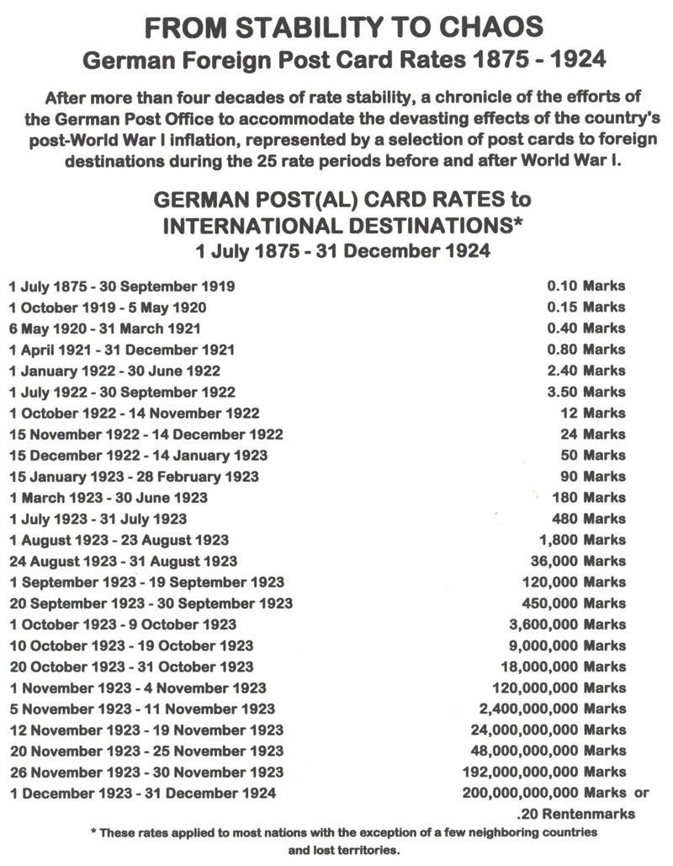
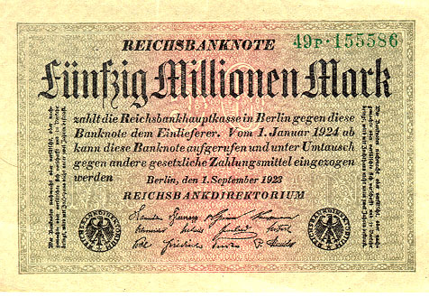
German Hyperinflation
German economy collapsed in 1923
  Loss of territory as part of Treaty of Versailles
  Hyper-inflation

Slide 8
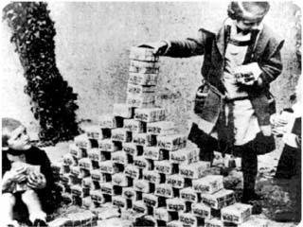
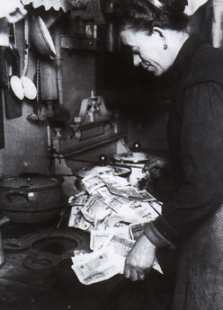
Pictures of Hyperinflation
What can you do with German money in 1923?
Make a fort (above) or burn it for heat (right)

Slide 9
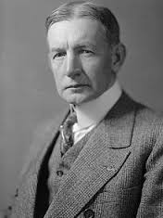
The Dawes Plan
U.S. plan to reorganize the German economy
  Lower annual war reparations payments
  German currency reorganized
  U.S. loans to Germany
Stabilizes the German economy
1924-1929 sees a return to relative economic prosperity

Slide 10
The Dawes Plan
United States
Germany
High-interest Loans
Interest on War Debts
Allies
War Reparations

Slide 11
The Great Depression

Slide 12
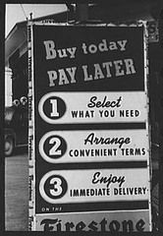
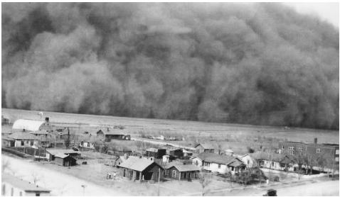
Causes of the Great Depression
Agricultural Depression
  Decline in wheat prices
  “Dust Bowl”
Bank Failures
Overproduction of Goods
  Production grew by 50%; wages increased at slower rate
Credit
  Buying goods (including stock) on margin

Slide 13
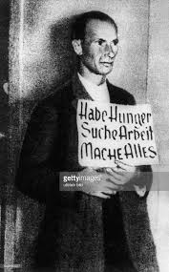
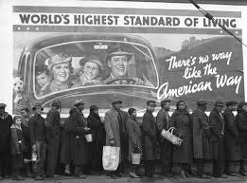
Effects of the Great Depression
Decline of world trade
  Countries turn to economic nationalism
Massive unemployment
  German unemployment 40%
Global decline in industrial production
  German production declines by 30%; France 20%
Poverty and hunger widespread
  Starvation in Germany

Slide 14

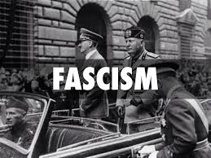
Reactions to the Depression
Government Changes
  Welfare State
    The New Deal
  Keynesian Economics
Political Radicalization
  Rise of communist and fascist parties
  Germany and Japan turn to state controlled economic growth

Slide 15
Totalitarianism and Mass Mobilization

Slide 16
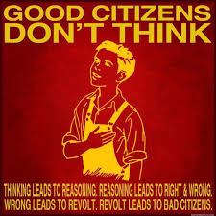
Characteristics of Totalitarianism
Attack liberal democracy and capitalism
State directed economy
State more important than the individual
Charismatic dictators
Depend upon mobilization of the masses
Embrace public welfare programs
Use censorship and propaganda
Women not permitted a public role

Slide 17
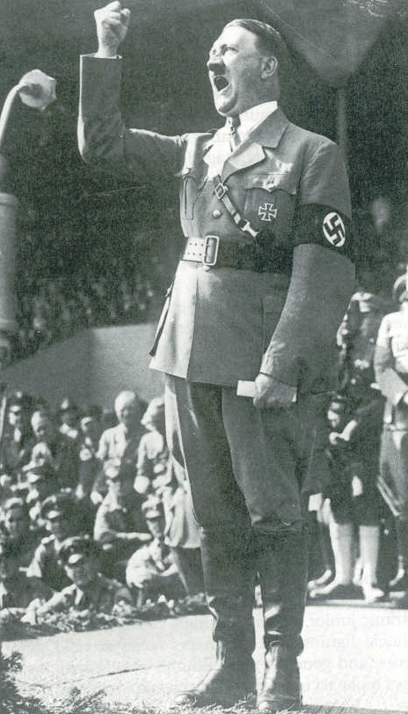
Rise of Adolf Hitler
Born in Austria
  High school dropout
Served in World War I
Arrested for role in Beer Hall Putsch
Writes Mein Kampf from prison
Became chancellor of Germany in 1933

Slide 18
Reforms of Adolf Hitler
Ignores provisions of the Treaty of Versailles
  Ends war reparations payments
  Uses militarization to ease the burdens of the Great Depression
  Many countries sympathized with Germany
Nazis seize complete political control
Beginning of the Holocaust
  Nuremburg Laws (1935)

Slide 19
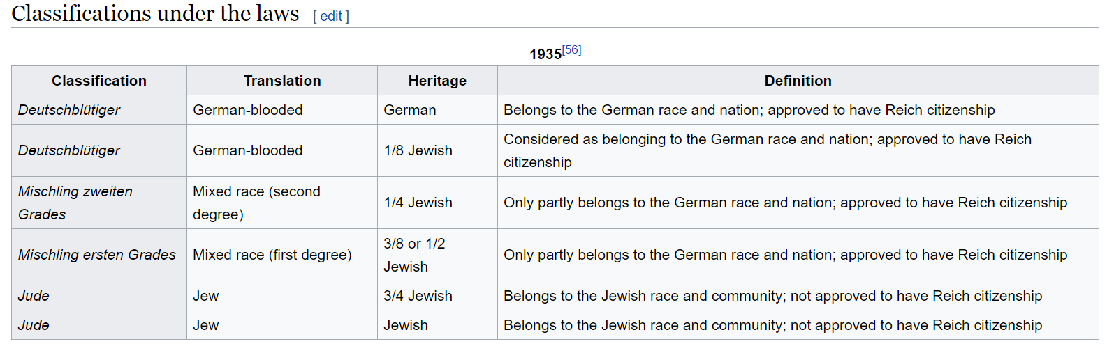

Slide 20
