Slide 1
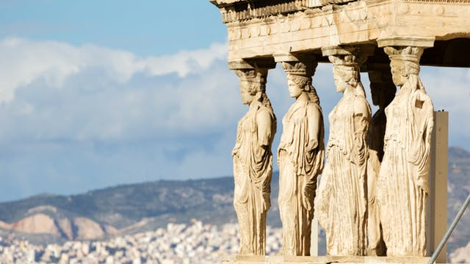
Ancient Greece
World History w/ Mr. Ng
2018-2019

Slide 2
It may be beneficial for you to write these down…
Vocabulary
Myceneans
Minoans
Pantheon
Aegean Sea
Questions to Consider
Describe 2 traits about Greece’s geography
What does Greece’s geography tell us about the people?
Who were the early settlers of Greece?
What is the Greek Pantheon?

Slide 3
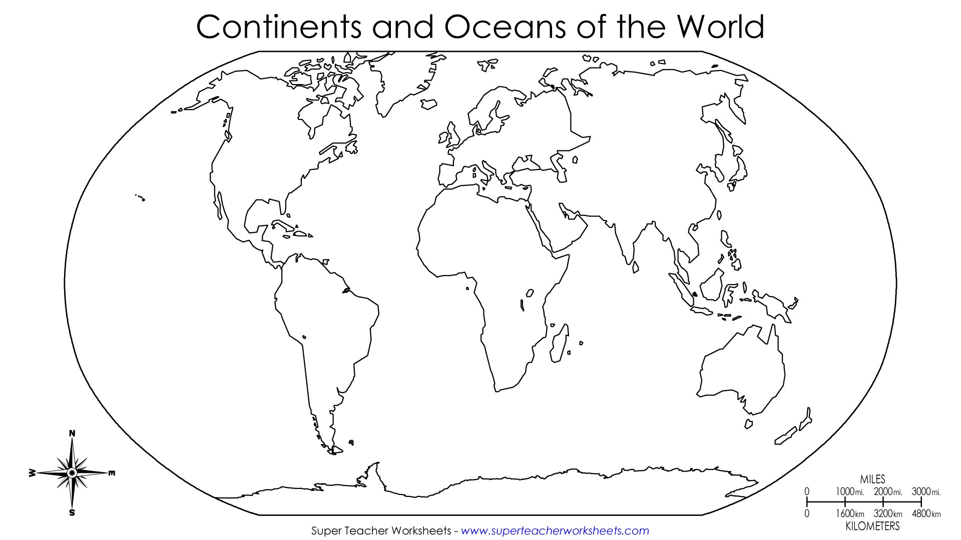
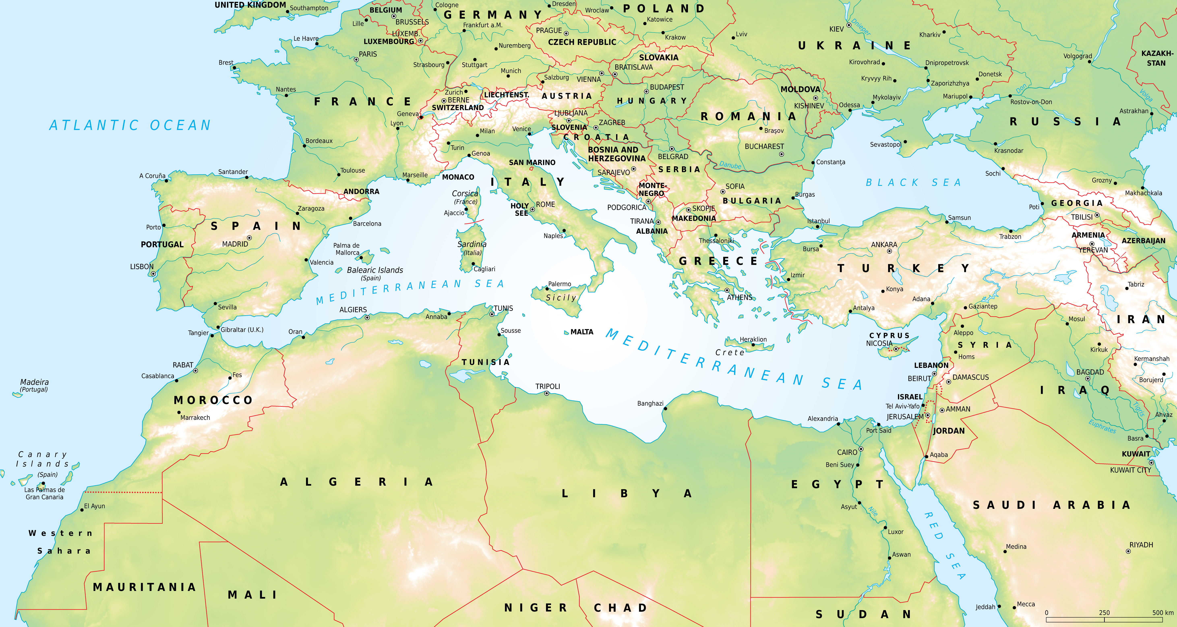
Where in the world is Greece?
Notes:
First, show image 1 and divide until we’ve honed in on the section
Second, show Mediterranean map and hone in
Then, pull up Google Earth and do a search on the globe

Slide 4
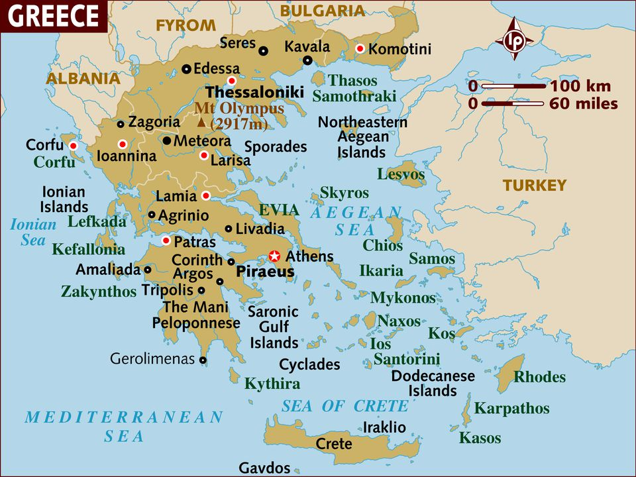
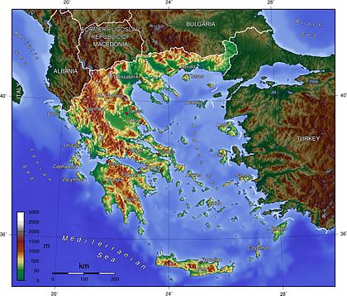
Greece: General Info
Greece is on the eastern Mediterranean Sea
The body of water associated to it is called the Aegean Sea
Greece is known for its many islands
1000-6000 islands
Greece is generally very mountainous
It’s about 80% of Greece’s landscape
Q: From this geographic analysis, what assumptions do you have about Greece and Greek peoples (lifestyle, diet, movement, communication)
Notes:
A:
The mountainous terrain makes farming difficult so both agriculture and seafood and trade are important
Much travelling by water, so likely ship experts
Localized groups in individual areas. Relatively independent

Slide 5
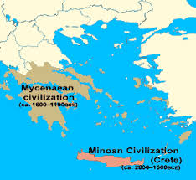
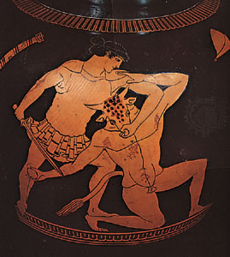
Greece: Early Peoples
Two early civilizations of Greece were called the Minoans and the Myceneans
The Minoans lived on the big island of Crete from 3000-1100BCE and had a developed culture (art, stories, writing)
Famous myth of a creature who lived underneath King Minos’ palace; a creature with a man’s body and a bull’s head
The Myceaneans conquered the Minoans in 1400BCE from northern Greece and adopted much of Minoan culture
Much of Greek culture derives from the Minoans and Myceaneans

Slide 6
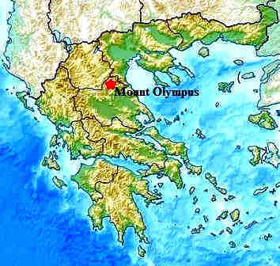
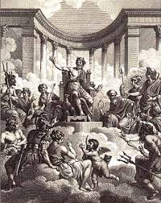
The Greek Gods
The Greek people believed in a Pantheon of Gods ( who lived on the top of Mount Olympus
These Gods overthrew the creator Gods (Titans) and controlled different things (nature, luck, life/death, seas, etc.)
Unlike many other religions, the Greek Gods are often involved in the lives of humans and are themselves human-like

Slide 7
Your Homework – Greek Character Posters
Artemis | Hercules | Hades | Zeus
Nike | Hypnos | Demeter | Hera
Hermes | Aphrodite | Poseidon | Ares
Hades | Hephaestus | Athena
Create a poster on A4 paper and include the following information:
Name of Greek Mythical Character
List their Power(s) (God of…)
Relatives (Who’s their father/mother, brother(s)/sister(s))
Symbol or Picture of character
Use Encyclopedia Britannica for information. Nothing else!
Use Color!

